Slide 1

SUPPORTING SMOOTH TRANSITIONS
Curriculum meeting
Insert your school badge here
WELCOME TO
Insert School/Setting Name
Insert date, time and presenter information
Notes:
Insert the school logo, date, time and name of presenter
Encourage parents to look around the classroom/provision for the first 10 minutes.
Room Set up – Think about the best way to arrange the seating, keeping in mind that you will want all parents to see the presentation and to be able to talk in small groups. You may want to play music and offer refreshments as parents arrive.
Give out induction packs as parents enter and keep a register so that you know who has attended.
Make sure the evaluation sheets/post-its and pens/pencils are on the chairs/tables for parents to access during the induction.
Welcome the parents/carers and introduce yourself

Slide 2

Your child
Tell us what your child enjoys doing by writing it on a post-it (make sure you include their name and stick to a board/leave on chair)
Think about what you want for your child when they start school and write it on a post-it (make sure you include their name and stick to a board/leave on chair)
Notes:
Dependent on the community your serve and the needs of your parents – you may want to include/exclude this activity. (Consider parents that are unable to write or may need support).
Ways to gather this information will still be available through the home visits and visits to your school.
If you decide to use this slide:
Choose one of the activities to complete with parents – delete the other.
Provide parents with post-its and pens/pencils.
Ensure you have space for parents to display their post-its.
The child is the focus for everyone and this needs to be established as soon as possible.

Slide 3
What will my child be learning?
Prime Areas of Learning | Specific Areas of Learning
Personal, Social and Emotional | Literacy
Communication and Language | Mathematics
Physical Development | Understanding the World
 | Expressive Arts and Design
Notes:
Use a piece of video to support discussions about children’s learning in relation to the areas of learning in the EYFS. It is best to use a video from your school/setting which shows children involved in child-initiated play. Ask the parents/carers what they think the children are learning and relate to the Prime and Specific areas of learning to demonstrate learning in the EYFS.
The purpose of this is to emphasis learning through play and how high-quality play will involve many of the areas of learning. Explain the adult role’s in supporting and extending learning through play. Emphasise how every child is unique, developing at their own rates, and in their own ways.

Slide 4
At the end of reception
Prime Areas of Learning |  |  |  | Specific Areas of Learning
Personal, Social and Emotional |  |  |  | Literacy
Self-regulation | Managing self |  | Building relationships | Comprehension | Word reading |  | Writing
Communication and Language |  |  |  | Mathematics
Listening, attention & understanding |  | Speaking |  | Number |  | Numerical patterns
Physical Development |  |  |  | Understanding the World
Gross motor skills |  | Fine motor skills |  | Past & present | People, culture & communities |  | The natural world
 |  |  |  | Expressive Arts and Design
 |  |  |  | Creating with materials |  | Being imaginative & expressive
Notes:
Provide an explanation of how children are assessed against each of the areas of development via 17 early learning goals. What-to-expect-in-the-EYFS-complete-FINAL-16.09-compressed.pdf could be highlighted to support parents/carers understanding of the early years foundation stage profile (EYFSP)

Slide 5



How does my child learn?
Characteristics of effective teaching and learning
Three characteristics of effective teaching and learning are:
playing and exploring - children investigate and experience things, and ‘have a go’
active learning - children concentrate and keep on trying if they encounter difficulties, and enjoy achievements
creating and thinking critically - children have and develop their own ideas, make links between ideas, and develop strategies for doing things
Notes:
School insert own photos
Explain that alongside the Areas of Development we look at the ways in which children learn.
The focus of the CoEL is on how children learn rather than what they learn i.e. process over outcome. This allows for teachers/practitioners to provide the right type of learning opportunities.
Optional to do the following dependent on the needs of your community and parents/carers
Activity - ask the parents to look at the photographs and discuss which of the characteristics of effective learning they think the child/children might be demonstrating.
Alternatively: Share some of your own photographs and provide examples of how the children are learning through play

Slide 6

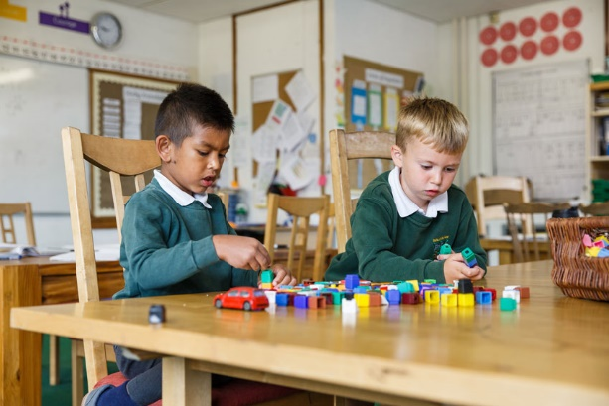
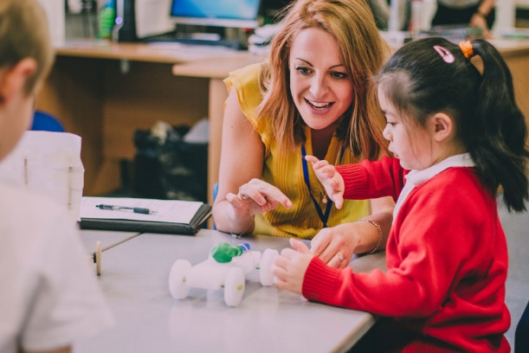
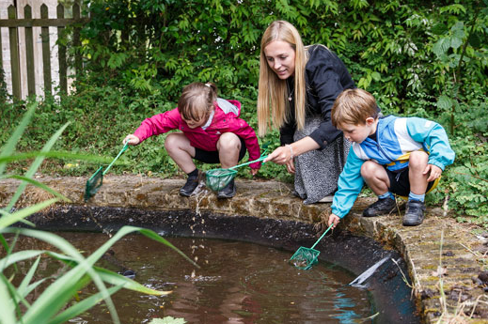

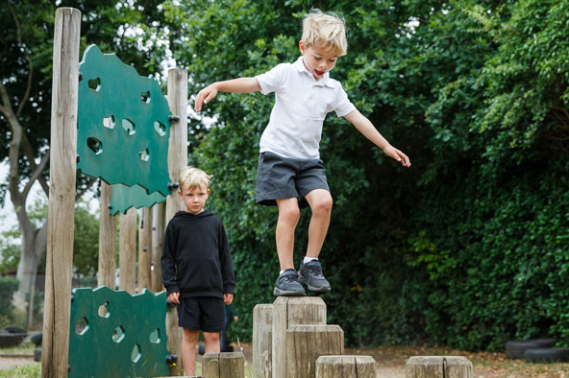
How will my child learn?
Notes:
Optional (or you may want to use this at a second session)
If preferred insert photos of the ways in which children learn in your school/provision.
Consider displaying examples resources used in school to support learning for parents/carers to explore.
Optional to do the following dependent on the needs of your community and parents/carers
Activity – Parents look at each of the photos and consider what is being learnt/developed. Encourage parents to discuss what they can see and what children might be learning in these situations. Parents/carers to be given a copy of the photos on the slide so that they can make notes and take it away to share with other family members.
In the discussion following the activity give a short explanation of why the activity in each photo is beneficial e.g. hanging from bars to build upper body strength (writing), listening to adults read a book (story time), board games (mathematics), sand/water play (problem solving), clearly labelled drawers/shelves (independence), role-play/collaborative play (make friends).

Slide 7


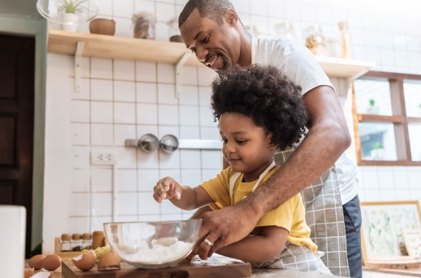

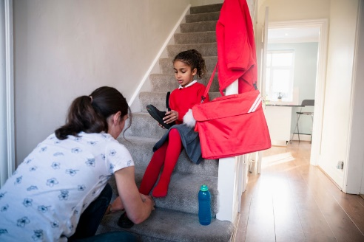

How can I support my child at home?
Communicate and talk with your child
Enjoy physical activities together
Have fun
exploring maths
Read, tell and make up stories together
Support your child to do things by themselves
Encourage your child to talk and play with others
Notes:
Explain that as the children progress through the school/setting they will be asked to help children at home with various activities (home learning), such as reading a book together. Their cooperation with these activities will be most appreciated and help their child to do well at school or nursery. Always speak of school/setting positively and if issues do occur they then need to be addressed in the appropriate manner (school/setting policy).
As you talk about each photograph explain how parents can help at home by using either your own ideas or some of the suggestions below.
Communicate and talk with your child - use every opportunity to have conversations with your child - play together, draw attention to objects in the environment, talk about and recall past experiences, cook together and encourage them to talk about their feelings. For example, talk about things that make them happy/unhappy.
Enjoy physical activities together - plan outdoor experiences such as visits to the park and walks. Encourage running, climbing, jumping, swinging and throwing games. Help the development of smaller muscles through cooking experiences, the use of playdough, building with bricks/Lego and opportunities to make marks and draw.
Fun with maths – play board or card games, count objects and compare them e.g. you have 3 and I have 4; I have more. Use opportunities at mealtimes e.g. you have 4 carrots on your plate, if you eat one how many will be left? During bath time use toys and containers that encourage filling and pouring; talking about things that are full and empty. When you are out and about draw attention to shapes and numbers in shops or in the street. Sing number rhymes together.
Read, tell and make up stories together- join the library and share books together, talk about the pictures and the print. Point out words that begin with the same letter as their own name and look for objects that begin with the same sound. Look for signs to read when you are out and about. Have a box available for your child that contains paper, notebooks, old envelopes, glue sticks, scissors and different writing tools, such as pens and pencils
Support your child to do things by themselves – let children put on their shoes/coats and do them up. Encourage them to wash their own hands, open food packets, use cutlery and say when they need the toilet or a drink.
Encourage social interactions - play together, encourage them to not interrupt, model taking turns and sharing. Model how to ask for something. Arrange times to play with other children. For example, meeting another family at the park

Slide 8
We support learning at home in a variety of ways
Look out for:
Parent consultations meetings
Home learning suggestions (that may include joint child and parent/carer mini projects)
Parent/carer workshops (for example, how to support early reading)
Information and tips in newsletters, on social media and the school website
Home/school learning packs
Information on displays around school
Notes:
Adapt this slide to reflect activities that your school provides to support parents/carers to help their child to learn at home. You may want to use photographs of the activities rather than text
Children learn best when we work together. Outline what is expected of parents/carers regarding homework etc.

Slide 9

Question Time
No question is a silly question…
If anyone has anything they would like to ask please feel free to
Notes:
Ensure you have 10 minutes for any questions
Remind parents that if something is worrying them now or when then child starts school/nursery it is important that they discuss their concerns with the class teacher or child’s key person.
If you have any questions personal to your family there will be an opportunity to ask these at the home visit or at a specially arranged meeting.
Mention use of parent volunteers and how you welcome this but DBS clearance will need to be completed. Explain how they could do this if anyone shows interest.

Slide 10
Future dates for your diary
Notes:
Insert important dates for example transition visit dates; sports day; any future parent events
Consider hosting curriculum workshops in the autumn term with the final weekly routine highlighting P.E. days etc. and focusing on supporting specific areas of learning such as phonics, early reading and writing and early maths

