Slide 1

SUPPORTING SMOOTH TRANSITIONS For You And Your Child
Insert your school badge here
WELCOME TO
Insert School/Setting Name
Insert date, time and presenter information
Notes:
Insert the school logo, date, time and name of presenter
Encourage parents to look around the classroom/provision for the first 10 minutes.
Room Set up – Think about the best way to arrange the seating, keeping in mind that you will want all parents to see the presentation and to be able to talk in small groups. You may want to play music and offer refreshments as parents arrive.
Give out induction packs as parents enter and keep a register so that you know who has attended.
Make sure the evaluation sheets/post-its and pens/pencils are on the chairs/tables for parents to access during the induction.
Welcome the parents/carers and introduce yourself

Slide 2



AIMS of the induction meeting
To give you an overview of
Early Years Foundation Stage (EYFS)
and what your child will be learning
To provide ideas we can effectively work together
and how you can best support your child at home
To help you understand what to
expect from us
Notes:
Insert own school photos
The curriculum for every child under the age of 5
Parents as partners
What this school does specifically – policies, expectations etc

Slide 3

EVALUATION TASK
Everyone has been given an evaluation sheet
Please fill in the before sections now
Notes:
Activity - Ask parents to complete the before section of evaluation form.
Provide an option for parents to do this when they arrive as you welcome them and then do not include in the PowerPoint
You could use an alternative method such as placing a counter in 2 baskets (yes or no) in response to ‘Do you know what your child will be learning as part of the EYFS)
We want to make sure they take something useful from this induction and this will help the school/setting understand what is working well/needs improving – the feedback can be used as tool to develop practice and communication with families.
You may want to adjust the question to meet your focus for the evaluation.

Slide 4
Meet the team
Headteacher
Red Class Teacher
Red Class TA
Notes:
Insert photos, names and roles of the practitioners.
Consider adding extra slides to present all the staff depending on the size of your school
The following slides will support the physical introduction of staff. They can add and interesting fact or two about themselves. Don’t forget to include the teaching assistants and MSAs working with the class (if known).
NB Each staff member could introduce themselves in person (sat at the front if present) as opposed to using photos or powerpoint slide

Slide 5
Why is transition so important for your child?
Transition: A process not an event
Each child is different and some may take a little longer to settle
Our transition processes are based on the best interests and needs of your child
We will work with you to help your child to settle and be confident in their new surroundings
Notes:
School insert own pictures
‘Transition: A process not an event’ reference that this statement appears in several documents/research etc – for example ICAN, Alistair Bryce Clegg, etc
Talk about each bullet point on the slide, reassuring parents that most will children settle well and that support is available for those who take a little longer. Explain that you will work in partnership because you recognise that parents are experts in knowing their child’s needs and staff are very experienced in supporting new children to settle.
Research suggests that children will find it easier to settle into school if they…
have strong social skills
can cope emotionally with being separated from their parents
are relatively independent in their own personal care
have a curiosity about the world and a desire to learn

Slide 6
Getting to know you and your child
We will do this by:
Home visits
Stay and play sessions
Information gathered from you and the previous setting
Transition for each child carefully planned with you and the class teacher/key person
Opportunities to ask questions and share concerns
Notes:
Edit this slide to reflect your own support for transition.
Talk about all the different ways you get to know the child and their family and the opportunities to share and exchange information about their child.
Explain how the key person relationship supports children to settle well.
Emphasise that staff are available to talk to parents who have concerns about their child.

Slide 7
Daily routines
8.45 | Arrival and self-registration
 | Activities led by an adult Children are able to access snack
 | Child initiated activities supported by adults
12.00 | LUNCH
1.00 | Activities led by an adult
 | Child initiated activities supported by adults
 | Story
3.15 | Home
Notes:
Insert the school’s/setting’s routine using parent friendly language and the lead person explaining what each part of the routine means.
Go through this and explain each session eg. child initiated activities and self-registration
Suggestion – add a photo of the school’s/setting’s visual timetable
Remember routines are adaptable throughout the year and change in response to the cohorts needs

Slide 8












Special week/days
Notes:
OPTIONAL SLIDE – share with parents/carers the range of themes/special weeks the school take part in including dates. (This can help prepare them for resourcing materials and when donations will be requested)

Slide 9
Supporting individual needs
Our SENCO is
Notes:
Insert the name and photo of the SENCo
If you are concerned about your child's learning and development discuss this with the class teacher or their key person
The school's Special Educational Needs Coordinator (SENCo) supports children who need additional help
Children are helped if they need support with toileting or continence issues
Explain that, after consultation with parents/carers, the school/setting can provide a range of additional help for children who need further support with their learning and development, this may include the support of other professionals, individual learning plans and for a small number of children an Education and Health Care Plan (EHCP). Parents are consulted and involved in any discussions and decisions about their child.
Explain how the school/setting helps children with toileting and continence issues.
See the HFL Incontinence Guidance (Coping with Incontinence - Supporting children with continence issues in early year’s settings and schools) which is provided as part of the transition materials.

Slide 10

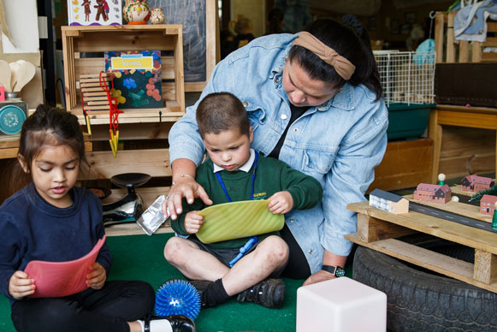
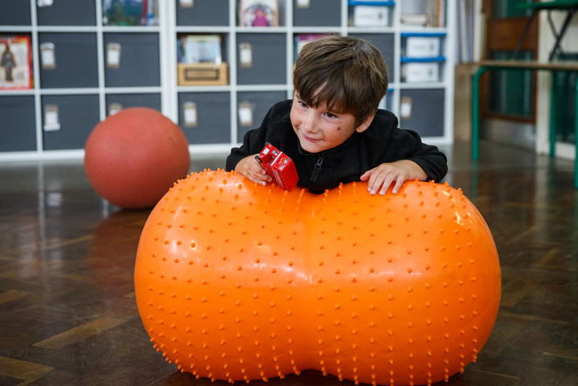

Support for your child
Notes:
Universal Free School Meals
Currently, children in Reception, Year 1 and Year 2 in state funded schools receive a free school lunch. This is government-funded and all children are eligible, respective of parental income or situation.
Schools receive additional funding for a number of eligible families such as
- Those with financial implications that qualify for free school meals
Children with families serving in the regular armed forces or have been registered as a ‘service child’ in the school census since 2011 or a child who has lost a parent/carer serving in the armed forces
Child looked after by local authority or in private foster care or has been adopted
The school require all parents to complete the appropriate form to check eligibility. (Provide at the induction)
If your child is eligible, we will, in liaison with parents/carers, allocate the funding to improve their educational outcomes. The funding can be used in a range of ways, including providing specialist equipment/services (for example, speech therapy), enrichment opportunities or in-session support. The school is very discreet with the confidential information you provide and they way in which support in provided.

Slide 11






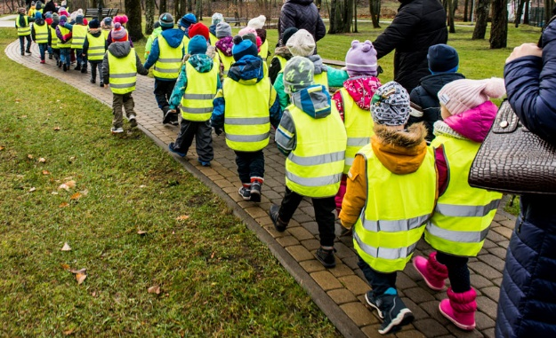
Keeping children safe is everyone’s responsibility
Notes:
Go through each point and give information related to the practice in your school and how you as a school help to keep children safe.
Safeguarding/Child protection Children have a right to be cared for and protected and that protecting them is everyone’s responsibility.
Explain that it is everyone's duty to respond to concerns about a child's safety. All staff are trained and follow procedures in the schools/settings Child Protection policy (copy on the website).
Mobile Phones explain why mobile phones must not be used in school/setting. Talk about why it can be dangerous to share children’s photographs on the internet and your school/setting policy regarding taking photos at school/setting events. Explain how the school/setting keep the children safe when using the internet. Tell parent’s where to find the policy (school/setting website).
Road safety and parking – promote walking to school but if using a car explain safe places to park. Talk about teaching children to cross the road safely.
Drop off and collection procedures - a password is required if unknown adults are collecting. Talk about making sure that gates/doors are closed and ensure that children hold an adult’s hand when leaving the building.
Accidents - explain how the school manage accidents and that first aid is administered in line with the school/setting policy. Talk about the fact that accidents are recorded and how risk assessments are undertaken to manage potential hazards.
Existing injuries - explain that if a child arrives at school/setting with an injury, as part of safeguarding procedures parents/carers will be asked to complete an 'Existing Injury' form.
First Aid – use your school’s First Aid policy to explain how and when you administer first aid. For example, talk about staff being first aid trained and that parents are asked to sign injury forms. Reassure parents that they would be contacted regarding any serious injuries that require further medical attention such as a head injury.

Slide 12




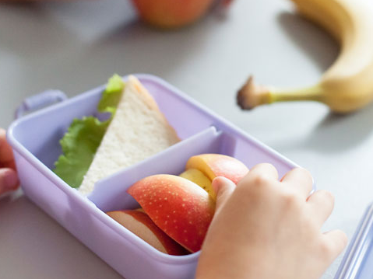
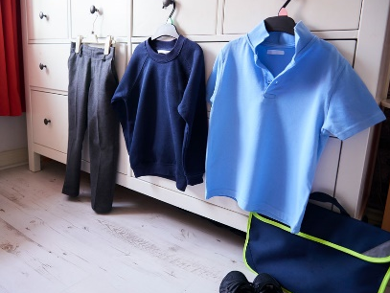


Keeping children safe is everyone’s responsibility
You…
Notes:
Go through each point and give information on how parents/carers can help support the school to keep children safe
Children who are unwell – explain the school policy keep a child off school at least 48 hours after the last attack of vomiting and diarrhea (quote NHS guidelines) informing the school/setting regarding contagious/infectious illnesses
Medication –policy on administering medication (for example, antibiotics or paracetamol) parents/carers responsibility to inform the school if their child is taking or requires any type of medication.
Individual medical needs –vital for parents to share information about their child’s individual medical needs such as allergies so that a Health Care Plan (HCP) can be completed with the parent/carer
Explain the healthy eating policy and share examples of a healthy packed lunch. Remind parents to name lunch bags, containers etc. Talk about arrangements for snack in the early years and whether parents contribute. Explain the school’s procedures for children accessing drinks of water. Talk about the policy regarding bringing in food for a child’s birthday.
Discuss possible allergies and how these are managed in school. For example, a ‘no nut policy.’ Other dietary requirements such as dairy/religious/veganism
Emphasise the importance of regular attendance, 96% attendance expected. Explain how it helps children to have a good routine and that children who attend regularly, settle more easily and make better progress with learning and development.
Children can sometimes be unwell and in which case they need to rest at home.
Explain the school’s/setting’s procedures and policy regarding the parent’s responsibility in alerting the school/setting if a child is absent or if they change address and contact details.
Talk about how parents will be informed about their child’s attendance and any incentives for good attendance (if applicable)
Uniform –what is needed and where it can be purchased, including a book and PE bags (some families new to our education system may not know what is expected). Alert parents to the availability of secondhand uniform. Talk about suitable types of shoes and that all clothing must be named including footwear, coats, scarves and gloves.
Wellington boots –to be kept at school/setting as children play outside in all weathers (including the rain). These must be named.
Outdoor policy - Clothes for cold weather – emphasis the importance of outdoor learning and that that there is no such thing as unsuitable weather just unsuitable clothing. Give examples of appropriate clothing for outdoor play in cold weather.
Clothes for warm weather – explain the school/setting’s sunscreen policy. Advise parents to provide sunhats, cotton clothing that protects the child’s arms. Explain how children have access to drinks of water.
Remind parents that everything needs to be named.

Slide 13

How we communicate with you
Communication is so important. It plays a huge role in ensuring that you are regularly sharing information with us to best support your child.
We do this by…
Daily chats at drop off and pick up time
Termly parent consultation meetings
Stay and Play sessions
Newsletters
Notice board (insert photo of your notice board)
Social Media – Facebook, Twitter
Email (insert email address)
School Website (add link to your website)
Notes:
Edit to suit what is in place in your school/setting
Add your website address, facebook page, twitter account details

Slide 14

Holiday Activities
Notes:
Link to activities in toolkit and describe some e.g. treasure hunt or getting ready for school
Mention family centres and library reading challenge

Slide 15
Evaluation Form
Review your evaluation sheet.
Please fill in the after sections now
Notes:
Activity - Ask parents to complete the after section of the evaluation form and to add any comments below. Evaluations are anonymous, remind them to leave the form for you before they leave.

Slide 16
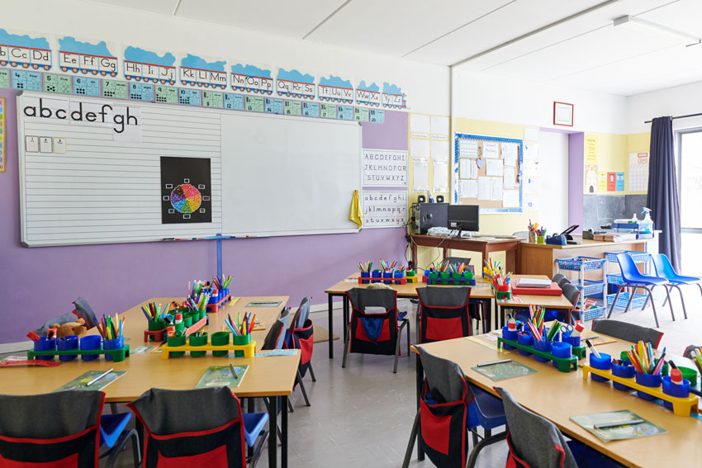
Before you go…
Take some photos of the classroom/provision and make sure you are in at least one of them.
You can then show your child you have been here!
Notes:
Activity Encourage parents to take photos that can be shared with their child. Ensure that photos/information of children are removed/covered in the setting

Slide 17

Question Time
No question is a silly question…
If anyone has anything they would like to ask please feel free to
Notes:
Ensure you have 10 minutes for any questions
Remind parents that if something is worrying them now or when then child starts school/nursery it is important that they discuss their concerns with the class teacher or child’s key person.
If you have any questions personal to your family there will be an opportunity to ask these at the home visit or at a specially arranged meeting.
Mention use of parent volunteers and how you welcome this but DBS clearance will need to be completed. Explain how they could do this if anyone shows interest.

Slide 18
Future dates for your diary
Notes:
Insert important dates for example transition visit dates; sports day; any future parent events
Consider hosting curriculum workshops in the autumn term with the final weekly routine highlighting P.E. days etc. and focusing on supporting specific areas of learning such as phonics, early reading and writing and early maths

Slide 19
We look forward to welcoming you and your child to
(insert name of school setting)
Notes:
Insert the name of your school/setting.
Photos of your own school/setting can be inserted

