Slide 1
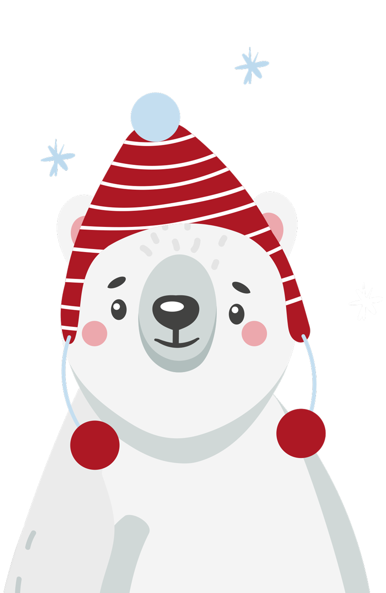
FESTIVE
Challenges

Slide 2

HFL EDUCATION
Challenges with penguins and polar bears in the corner are designed for KS1.
Challenges with hot chocolate and reindeer in the corner are designed for KS2.
All slides can be edited to change the fluency range.
Example solutions can be found underneath each slide in the notes section.
Email scanned or photographed pupil responses to primarymaths@hfleducation.org to be featured in our December social media posts.

Slide 3
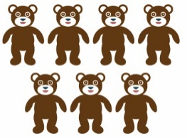

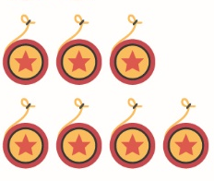
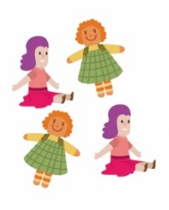
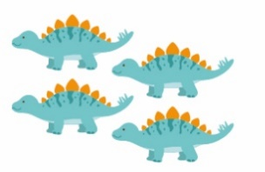

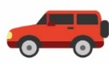






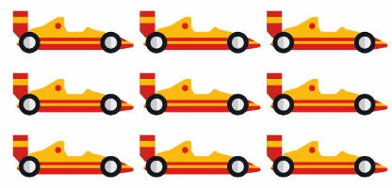


TOY SORT
The toys need sorting into boxes. The number on the box is the total number of toys to go inside.
Each box must contain two equal groups of toys.
Can you organise the toys correctly?
14
6
8
10
18
Notes:
14 = 7 bears + 7 yo-yos
6 = 3 cars + 3 planes
8 = 4 dolls + 4 dinosaurs
10 = 5 balls + 5 pencils
18 = 9 cards + 9 ducks

Slide 4
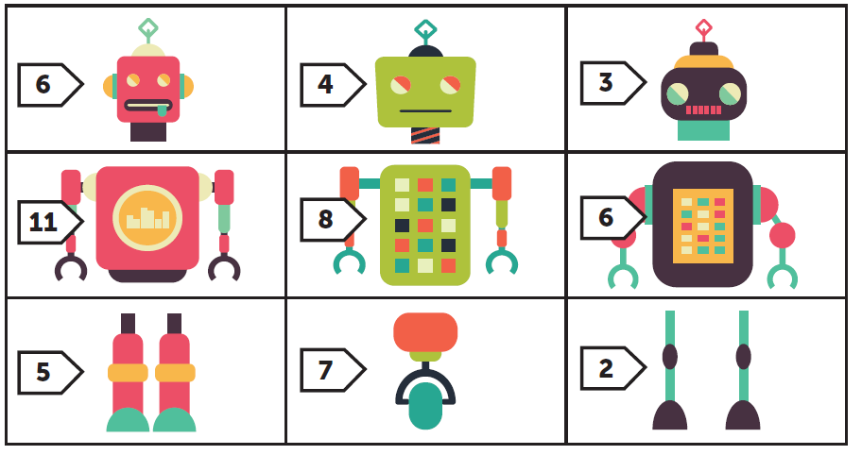
Toy factory
Robots are being made in a factory.
Every robot needs a head, body and set of legs.
Each part of the robot has a value. The total value of the robot must not be more than 20.
Can you build a robot?
Is there more than one way? Have you found them all?
This activity could be adapted for different year groups by changing the value of each robot part.
Notes:
Example responses:
6 + 8 + 2 = 16
6 + 7 + 2 = 15
6 + 4 + 2 = 12
6 + 4 + 3 = 12
6 + 4 + 6 = 16

Slide 5

Wrap the presents 1
Follow the clues and colour the wrapping paper.
The blue present is in the middle.
The yellow present is next to it on the left.
In the bottom row, the red present is between the purple and orange presents.
There is a pink present in the top right corner and a spotty present to the left of it.
The present above the yellow one has stars on it.
Which present still needs colouring?
Choose a colour for this one.
Notes:
Top row = stars, spots, pink
Middle row = yellow, blue, own choice
Bottom row = purple, red, orange OR orange, red, purple

Slide 6

Balancing act
How many parcels could be added to each box to make the front and back of each sleigh balance?
5
7
10
8
12
This activity could be adapted for different year groups by changing the numbers.
11
Is there more than one way to balance each sleigh?
Notes:
Sleigh 1: 10 = 5 + 5
There is only one way to balance this sleigh.
Sleigh 2: 10 + 5 = 7 + 8
Any combination of 2 numbers that total 15.
Sleigh 3: 1 + 12 + 5 = 11 + 7
There are infinite combinations for this sleigh.

Slide 7

MACHINE MALFUNCTION 1
3
4
5
6
5
7
9
11
Instead of wrapping the numbers in festive paper, the machine is changing each number.
3 has become 5.
6 has become 11.
The machine is doing two calculations to each number.
Which two calculations does the machine make to change each number?
Notes:
Double the number and then subtract 1

Slide 8
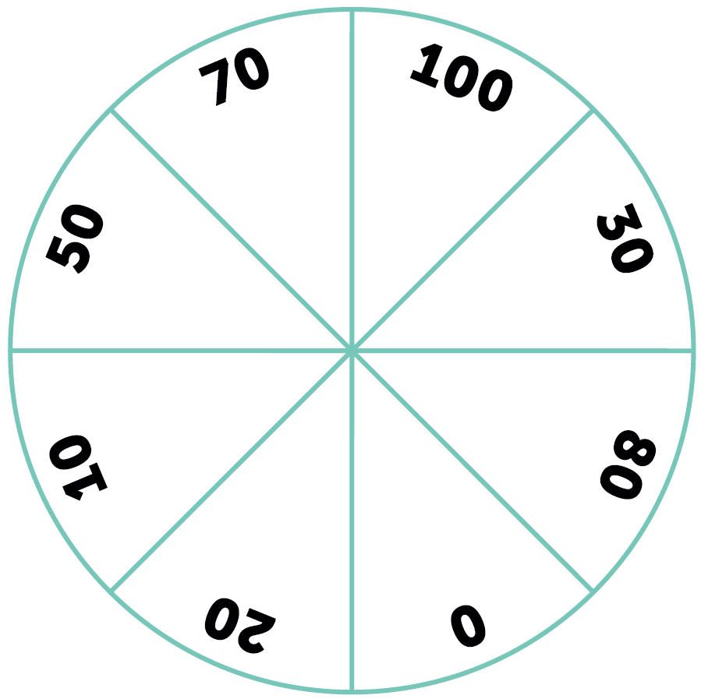
Toy test
Toys are being tested in the workshop. Can you help?
With two darts:
Could you hit two numbers that total 100?
Could you hit two numbers that total 80?
Is there more than one way?
With three darts:
Could you hit three numbers that total 100?
Could you hit two numbers that total 80?
Is there more than one way?
Could you hit numbers that total every multiple of ten up to 100 with:
Two darts?
Three darts?
Notes:
2 darts to total 100
0 + 100
20 + 80
30 + 70
50 + 50
2 darts to total 80
0 + 80
10 + 70
30 + 50
3 darts to total 100
0 + 20 + 80
0 + 30 + 70
0 + 50 + 50
10 + 10 + 80
10 + 20 + 70
3 darts to total 80
0 + 0 + 80
0 + 10 + 70
0 + 30 + 50
10 + 20 + 50
20 + 30 + 30
You could total every multiple of 100 with 2 or 3 darts.

Slide 9


Reindeer Herding
Here’s an example.
The reindeer herder wants to add fences to the enclosure so that there are two separate parts. In each enclosure, there should be an even number of reindeer.
How many ways can the herder do this?
Would it be possible for one group to have an even number of reindeer and one group to have an odd number?
Why? Why not?
Notes:
It is not possible to group the reindeer into 1 odd and 1 even group.
Odd + even = odd number of reindeer overall

Slide 10
Reindeer Herding
The reindeer herder wants to add fences to the enclosure so that there are two separate parts. In each enclosure, there should be an even number of reindeer.
How many ways can the herder do this?
Would it be possible for one group to have an even number of reindeer and one group to have an odd number?
Why? Why not?
Notes:
It is not possible to group the reindeer into 1 odd and 1 even group.
Odd + even = odd number of reindeer overall

Slide 11
Polar postie’s Problem 1
The polar posties are sorting through letters.
They need to arrange the envelopes so that the house numbers in each row and column add up to 12.
Using the numbers 1 to 8, can you label the envelopes so that each row and column total 12?
Some numbers may appear more than once. Some numbers may not appear at all!
Is there more than one way to label the envelopes?
Notes:
Solutions could include:
2, 7, 3
2, 4, 6
8, 1, 3
8, 1, 3
3, 5, 4
1, 6, 5

Slide 12
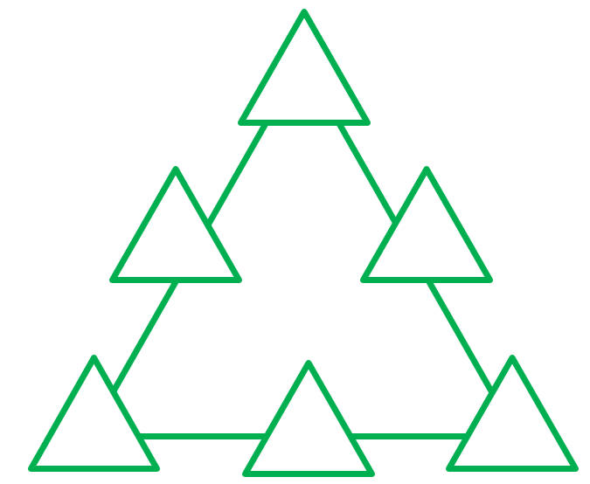
TRIANGLE TRICK 1
Position the numbers in the small triangles so that each side of the large triangle has an equal sum.
1 2 3 4 5 6
Notes:
Clockwise around the triangles starting from the top:
1, 5, 3, 4, 2, 6

Slide 13
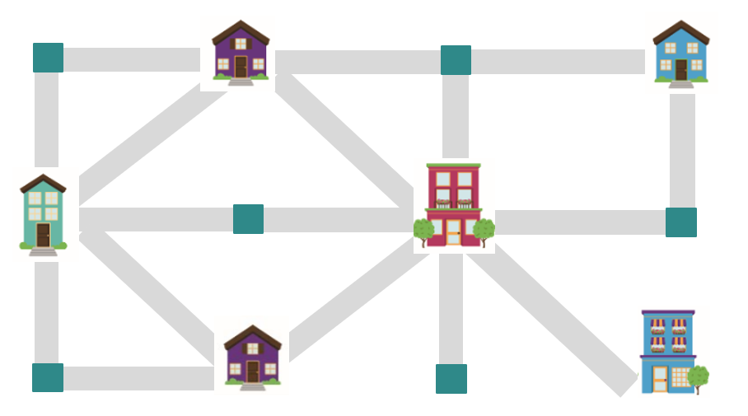
DELIVERY DRAMA
A card needs to be delivered to each house.
Choose where you want to start.
Can you visit each house in 8 moves or fewer?
Time is running out!
Without visiting a house more than once, what is the shortest path?
Is it possible to map a path to each house which is exactly 10 moves long?
Notes:
The fewest number of moves without revisiting a house more than once is 6.
This involves starting at the bottom right-hand corner house.
It is not possible to map a path with exactly 10 moves.
Adaptations could include:
Adding or removing pathways or houses
Adding parameters such as specifying a start or end point
Making some paths one way only

Slide 14

Winter weather 1
The temperature is 12˚C. It has risen by 8˚C since this morning.
What was the temperature this morning?
Outside, the temperature was 13˚C.
As it got dark, the temperature dropped by 7˚C.
How cold did it get?
The temperature in Greece was 11˚C and in Norway, it was 3˚C.
What was the difference in temperature?
Notes:
The temperature this morning was 4˚C.
It got to 6˚C.
The difference was 8˚C.

Slide 15

WHO SAT WHERE?
Mr and Mrs Hussain are having lunch with their three children; Amir, Youssef and Zainab.
Use the clues to find out who sat where.
Window
Zainab and Mr Hussain do not want to sit by the door.
Youssef likes to sit near the door.
Amir wants to sit at the end of the table.
Mrs Hussain sits close to Amir, and she is opposite Zainab.
Door
Notes:
Zainab Mr Hussain
Amir
Mrs Hussain Youssef

Slide 16
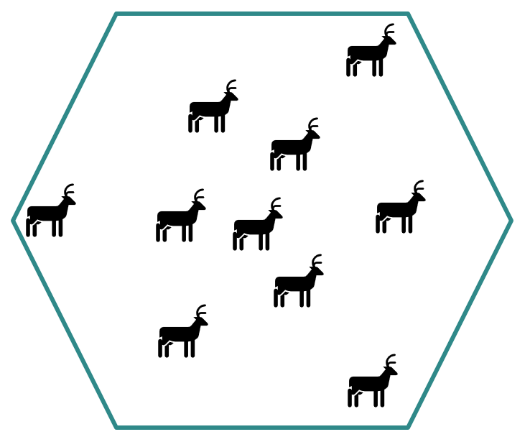
ROAMING REINDEER 1
There are 10 reindeer in a large enclosure.
The reindeer herder would like to build circular fences within the enclosure so that each reindeer has its own enclosure.
How could it be done?
Can you work out how to give each reindeer its own enclosure with just three circles?
Notes:
Example solution on slide 18

Slide 17
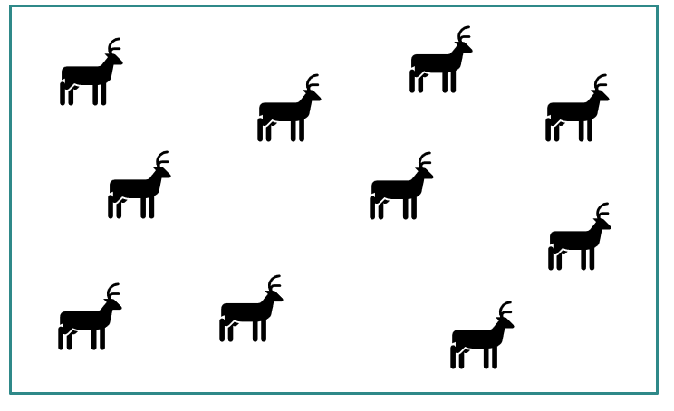
ROAMING REINDEER 2
This time, the reindeer herder wants to build triangular fences within the enclosure so that each reindeer has its own enclosure.
How could it be done? Is there more than one way?
Are there any empty enclosures that the herder
could add extra reindeer to?
Notes:
Example solution on slide 18

Slide 18
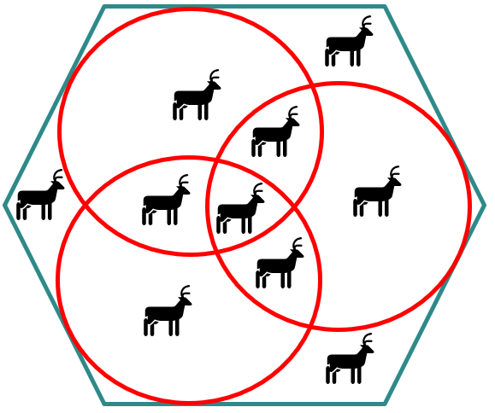
ROAMING REINDEER - solutions
Roaming reindeer 1 Roaming reindeer 2

Slide 19
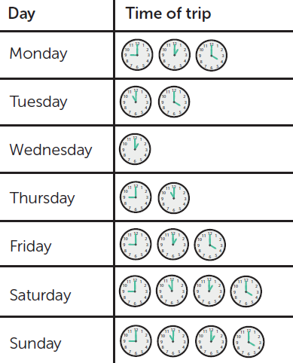
All on board
The Polar Express is getting ready to roll!
The table shows the days and times the train leaves.
Can you write five facts about the Polar Express timetable?
What’s the most unique fact you can think of?
Notes:
Facts could include descriptions of which times the trains leave on each day, ‘earliest’ and ‘latest’ trains or comparisons between the number of trips each day.

Slide 20
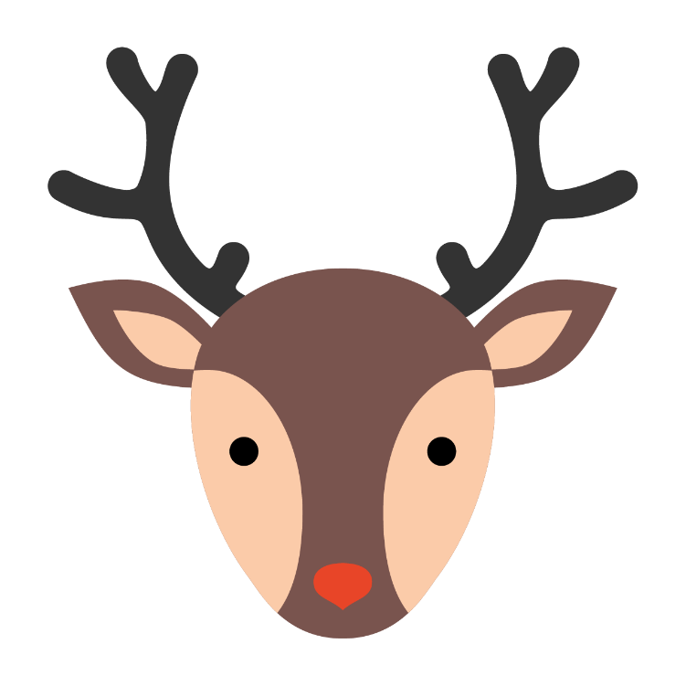

Mirror magic
What do you notice about the picture of the reindeer?
Can you see it has one line of vertical symmetry?
What could a snowman with a line of symmetry look like?
What about a snowflake? Or a penguin?
What different designs can you create?
Can you draw a festive picture with more than 1 line of symmetry?

Slide 21

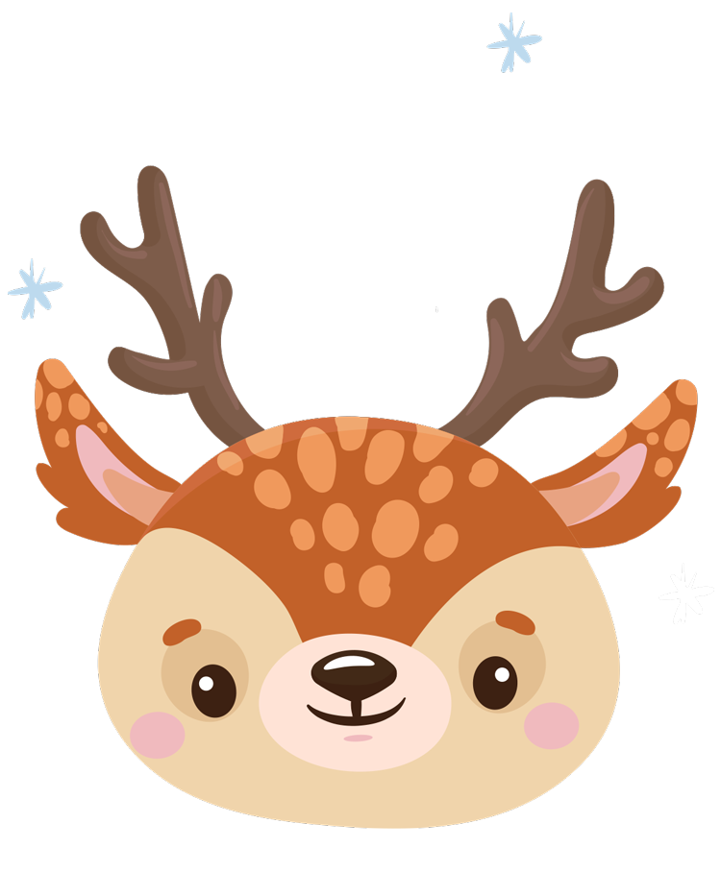
Penguin Parcels
Three penguins were wrapping up 23 gifts.
Each penguin wrapped up an odd number of gifts.
Each penguin wrapped up a different number of gifts.
How many gifts did each penguin wrap up?
How many different possibilities are there?
Notes:
There are 8 possible combinations:
1, 3, 19
1, 5, 17
1, 7, 15
1, 9, 13
3, 5, 15
3, 7, 13
3, 9, 11
5, 7, 11

Slide 22
Calendar mix-up
 | 3 | 2 |  | 19
4 | 14 | 9 | 16
8 | 15 | 13 | 11 | 18
 | 10 | 17 | 12 | 1
7 |  |  | 6 | 5
On this calendar, the numbers in each row and each column add up to the same number.
Can you place the numbers between 20 and 25 correctly?
What is your strategy?
Could you create your own?
This activity could be adapted for different year groups by pupils creating their own within an appropriate number range. This could involve whole numbers, decimals or fractions.
Notes:
Each row and column add to 65. Row 3 can be used as a starting point.
Row 1: 21
Row 2: 22
Row 4: 25
Row 5: 23, 24

Slide 23
Star puzzle 1
19
10
Place the numbers 1-9 in the correct boxes so that:
the amount in each star is equal to the sum of the four surrounding spaces
each colour total is correct (shown in the circles)
23
19
13
14
18
Notes:
Top row: 7, 2, 3
Middle row: 6, 4, 1
Bottom row: 8, 5, 9
Top create more possibilities for arrangements, remove the requirements for the numbers to total the values in the circles; focus only on the star totals.

Slide 24
NEIGHBOURING NUMBERS
Position the numbers on the stars so that numbers joined by grey lines are not one more or one less than each other.
For example, 12 must not be joined
to 11 or 13.
11
12
13
14
15
16
Notes:
Possible solution - clockwise from the top:
13, 11, 14, 16, 12, 15

Slide 25
MACHINE MALFUNCTION 2
7
9
10
11
35
49
56
63
Instead of wrapping up the numbers in festive paper, the machine has changed each number.
7 has become 35.
11 has become 63.
The machine is doing two calculations to each number.
Which two calculations does the machine make to change each number?
Notes:
Subtract 2, multiply by 7

Slide 26
Present packing
Presents are being packed into different shaped boxes.
12 presents can be packed into 3 different shaped rectangular boxes.
Which numbers (up to 40) have the most different ways they can be organised into rectangular boxes?
What is the link to factors?
Notes:
Numbers that could be packed into…
3 rectangular boxes (3 factor pairs):
12
18
20
28
32
4 rectangular boxes (4 factor pairs):
24
30
40
5 rectangular boxes (5 factor pairs (including the square)):
- 36

Slide 27

Festive decoration
The pine tree is decorated with sparkly baubles.
Some have 2 stars, some have 3 stars, and some have 4 stars.
On the tree, there are a total of 54 stars.
There are the same number of each type of bauble.
How many of each must there be?
Notes:
Total of 54 stars in total.
There are 6 of each of the following baubles:
Dark blue (2 stars) 12 stars
Light blue (3 stars) 18 stars
Purple (4 stars) 24 stars
54 stars

Slide 28
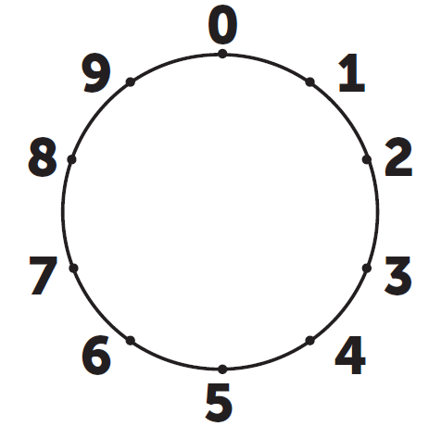
Multiple stars
Look what happens when you use a dial to join the ones digits in multiples of 6. They make a star!
Can you find another multiplication table that makes a star pattern?
What patterns do other times tables make?
0
6
12
18
24
30
36
…
Notes:
Multiplication tables that make a star pattern:
3x table
4x table
6x table
7x table
Other patterns
2x table = pentagon
5x table = straight line
8x table = pentagon
9x table = decagon
11x table = decagon
12x table = pentagon
The 10x table remains at 0 and so creates a ‘dot’.

Slide 29
icy factors
The icicle on the mixed-up times table grid contains clues to the missing factors.
Can you place the factors 2-10 in the green row and column? Factors can be used more than once.
Where did you start and why?
x
 | 8
 |  |  |  |  |  |  |  | 100
 |  |  |  |  | 36 |  | 27
 |  |  |  | 20 |  | 36
 |  | 14 |  |  |  |  |  | 20
 |  |  |  | 40 | 32
 |  |  | 6 |  |  |  | 9
 |  | 49 |  |  | 28
 | 40 |  |  |  |  |  |  |  | 5
 |  |  |  |  | 24
Notes:
Across the row: 4, 7, 2, 5, 4, 9, 3, 10, 5
Down the column: 2, 10, 9, 4, 2, 8, 3, 7, 10, 6

Slide 30
Wrap the presents 2
This present has been wrapped in different types of paper.
Can you work out what fraction of the present is covered by each type of paper?
Explain how you know.
Notes:
2 pieces of wrapping paper cover $\frac{1}{4}$ each in a square shape
1 piece of wrapping paper covers $\frac{1}{4}$ in a rectangle shape
1 piece of wrapping paper covers $\frac{1}{8}$ in a rectangle shape
2 pieces of wrapping paper cover $\frac{1}{16}$ each in a square shape

Slide 31
All on board
The Polar Express is getting ready to roll!
The table shows the days and times the train leaves.
Can you write five facts about the Polar Express timetable?
What’s the most unique fact you can think of?
Notes:
Facts could include ‘earliest’ and ‘latest’ trains, time differences or comparisons between the number of trips each day.

Slide 32

Winter weather 2
The temperature is 5˚C. It has risen by 8˚C since this morning.
What was the temperature this morning?
Outside, the temperature was -1˚C.
As it got dark, the temperature dropped by 5˚C.
How cold did it get?
The temperature in Denmark was 2˚C and in Canada, it was -9˚C.
What was the difference in temperature?
Notes:
The temperature this morning was -3˚C.
It got to -6˚C.
The difference was 11˚C.

Slide 33
pine puzzle
A fraction wall has been used to make this pine tree picture.
Each row is worth one whole.
List all the fractions used to make the tree.
Order the fractions from largest to smallest.
Notes:
Fractions used to make the tree (top to bottom):
$\frac{1}{7} \frac{2}{6} \frac{3}{5} \frac{4}{4} \frac{1}{3}$
Order from largest to smallest:
$\frac{4}{4} \frac{3}{5} \frac{2}{6}and\frac{1}{3} \frac{1}{7}$

Slide 34




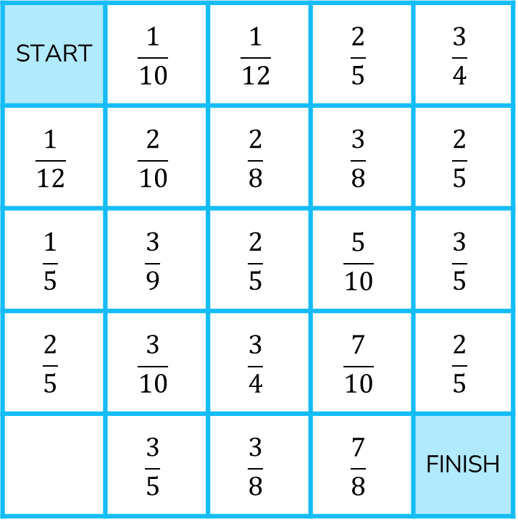
Start to finish
START | $$\frac{1}{10}$$ | $$\frac{1}{12}$$ | $$\frac{2}{5}$$ | $$\frac{3}{4}$$
$$\frac{1}{12}$$ | $$\frac{2}{10}$$ | $$\frac{2}{8}$$ | $$\frac{3}{8}$$ | $$\frac{2}{5}$$
$$\frac{1}{5}$$ | $$\frac{3}{9}$$ | $$\frac{2}{5}$$ | $$\frac{5}{10}$$ | $$\frac{3}{5}$$
$$\frac{2}{5}$$ | $$\frac{3}{10}$$ | $$\frac{3}{4}$$ | $$\frac{7}{10}$$ | $$\frac{2}{5}$$
 | $$\frac{3}{5}$$ | $$\frac{3}{8}$$ | $$\frac{7}{8}$$ | FINISH
Find a path from the START to the FINISH where the fractions increase in size with each step.
You can move in any direction.
Explain how you knew that the next fraction was larger.
What’s the shortest pathway?
What’s the longest pathway?
Notes:
Shortest pathway: START $\frac{2}{10} \frac{2}{8} \frac{5}{10} \frac{7}{10}$ END
Longest pathway: START $\frac{1}{12} \frac{1}{10} \frac{2}{10} \frac{2}{8} \frac{3}{8} \frac{2}{5} \frac{5}{10} \frac{3}{5} \frac{7}{10} \frac{3}{4} \frac{7}{8}$ END
Strategies could include comparisons to benchmarks (closer to 0, $\frac{1}{4} \frac{1}{2} \frac{3}{4}$or 1), using a labelled number line, converting to common denominators or use of a fraction wall.

Slide 35
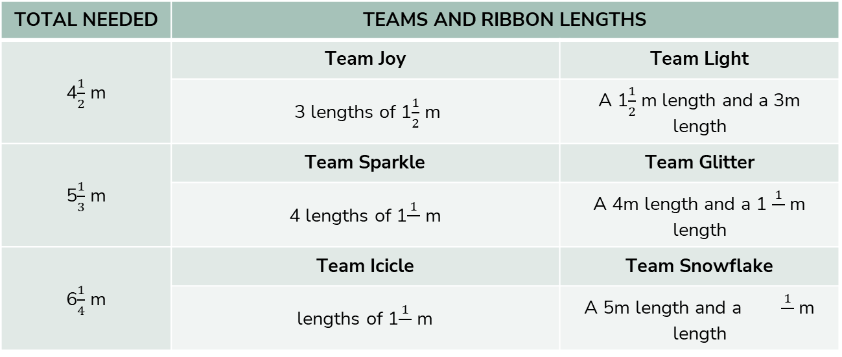
Ribbon for wrapping
Teams are cutting lengths of ribbon for gift wrapping.
The table shows how the ribbon is cut by each team.
TOTAL NEEDED | TEAMS AND RIBBON LENGTHS
4$\frac{1}{2}$ m | Team Joy | Team Light
 | 3 lengths of 1$\frac{1}{2}$ m | A 1$\frac{1}{2}$ m length and a 3m length
5$\frac{1}{3}$ m | Team Sparkle | Team Glitter
 | 4 lengths of 1$\frac{1}{}$ m | A 4m length and a 1 $\frac{1}{}$ m length
6$\frac{1}{4}$ m | Team Icicle | Team Snowflake
 | lengths of 1$\frac{1}{}$ m | A 5m length and a $\frac{1}{}$ m length
This activity could be adapted for different year groups by providing a length of border roll for them to cut 4 ½ m into 3 equal lengths and measure to find each length.
What do you notice about the lengths being cut? Can you continue the pattern?
Notes:
Team Sparkle: 4 lengths of 1$\frac{1}{3}$m
Team Glitter: A 4m length and a 1$\frac{1}{3}$m length
Team Icicle: 5 lengths of 1$\frac{1}{4}$m
Team Snowflake: A 5m length and a 1$\frac{1}{4}$m length

Slide 36


A take away treat
What is the value of if…
squared =
 |  | . | 3 | 0 | 7
- | 0 | .
 | 2 | . | 4 | 0
= the product of and
The difference between and
equals
Notes:
Solution on next slide

Slide 37
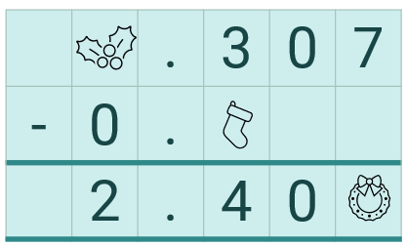




A take away treat - solution
2
1
If is worth… | 2 | 3
 | 9² = 81 | 9² = 81
 | 162 = 81 x 2 | 243 = 81 x 3
 | 162 – 7 = | 243 – 7 =
 | 155 | 236
3
9
7

Slide 38
Delivery tracking
11
10
9
8
7
6
5
4
3
2
1
0
Parcel delivery is being carefully tracked on a grid.
The grid shows the vehicle’s current position.
Delivery 1
Double the x coordinate and triple the y coordinate.
Mark this delivery on the grid.
Delivery 2
Some information is missing from the label.
The x and y coordinates have a difference of 3,
e.g. (7,4) or (4,7).
Where could this delivery be?
Mark as many possibilities as you can.
Where could this delivery not be?
This activity could be adapted for different year groups by using a space on a grid and saying the sleigh needs to move two places to the left and up one square.
0 | 1 | 2 | 3 | 4 | 5 | 6 | 7 | 8 | 9 | 10 | 11
Notes:
Delivery 1:
(8, 9)
Delivery 2:
The delivery spot could be at any point with coordinates with a difference of 3, e.g. (1, 4), (6, 9) or (8, 11)

Slide 39
Polar postie’s Problem 2
The polar posties are sorting through letters to deliver to Decimal Street.
They need to arrange the envelopes so that the house numbers in each row and column add up to 1.2.
Using the numbers 0.1 to 0.8, can you arrange the envelopes so that each row and column total 1.2?
Some numbers may appear more than once. Some numbers may not appear at all!
Is there more than one way to arrange the numbers?
Notes:
Solutions could include:
0.2, 0.7, 0.3
0.2, 0.4, 0.6
0.8, 0.1, 0.3
0.8, 0.1, 0.3
0.3, 0.5, 0.4
0.1, 0.6, 0.5

Slide 40
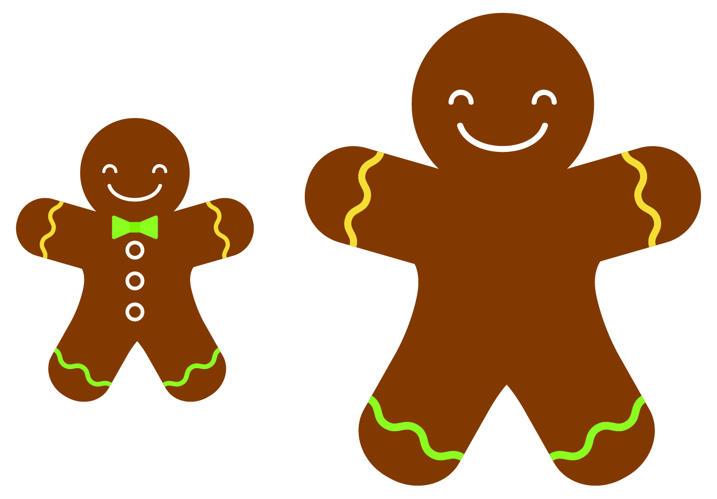
Gingerbread baking
Gingerbread biscuits are being baked to sell at the Winter Fayre.
Out of the 1,200 biscuits made, 97% of them have baked successfully and have no missing pieces.
How many whole Gingerbread biscuits can be sold at the Fayre?
Can you find 3 different ways to calculate this?
Can you find a method that nobody else has thought of?
Which method is most / least efficient?
Notes:
1164 can be sold at the fayre.
Possible strategies:
100% - 3% = 97% → 1,200 – 36 = 1164
50% + 40% + 7% = 97% → 600 + 480 + 84 = 1164

Slide 41
Keeping warm
To keep warm, the reindeer like to run around their outdoor field.
The perimeter of their field is 70m.
The length of their field is four times the width.
Can you calculate the length and width of the field?
Can you calculate the area?
Notes:
Length = 28m
Width = 7m
Area = 196m

Slide 42
Festive dinner
Here’s an example layout for 10 guests.
The tables for a festive dinner are regular hexagons.
Tables can be pushed together and there are 15 people coming. No more than one person will seat on a side.
Arrange the tables to seat the 15 people.
Work out the length of festive ribbon needed to run around the perimeter of the table arrangement.
What table arrangement would use the least ribbon?
What table arrangement would use the most ribbon?
50cm

Slide 43
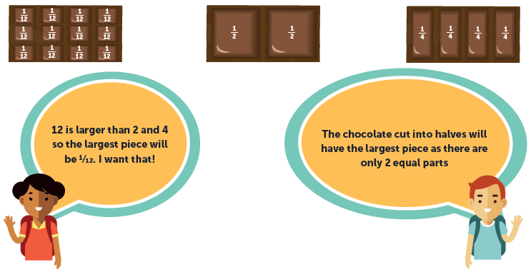
Sharing the chocolate
The children want to find the largest fraction of chocolate to enjoy.
Who is correct? Why?
Can you find some equivalent fractions of chocolate that would give them an equal share?
Notes:
The child on the right is correct.
The whole chocolate bars are equal in size so one of two equal pieces will be larger than one of twelve equal pieces.

Slide 44
Star puzzle 2
Place the numbers
0.1, 0.2, 0.3, 0.4, 0.5, 0.6, 0.7, 0.8 and 0.9
in the correct boxes so that:
the amount in each star is equal to the sum of the four surrounding spaces
each colour total is correct (shown in the circles)
1.9
1.0
2.3
1.9
1.3
1.4
1.8
Notes:
Top row: 0.7, 0.2, 0.3
Middle row: 0.6, 0.4, 0.1
Bottom row: 0.8, 0.5, 0.9
Top create more possibilities for arrangements, remove the requirements for the numbers to total the values in the circles; focus only on the star totals.

Slide 45


TRIANGLE TRICK 2
Position the numbers in the small triangles so that each side of the large triangle has an equal sum.
3 tenths 4 tenths
0.7 0.8
$$\frac{5}{10}$$
$$\frac{6}{10}$$
Notes:
Clockwise around the triangles starting from the top:
3 tenths, 0.7, $\frac{5}{10}$, $\frac{6}{10}$, 4 tenths, 0.8

Slide 46

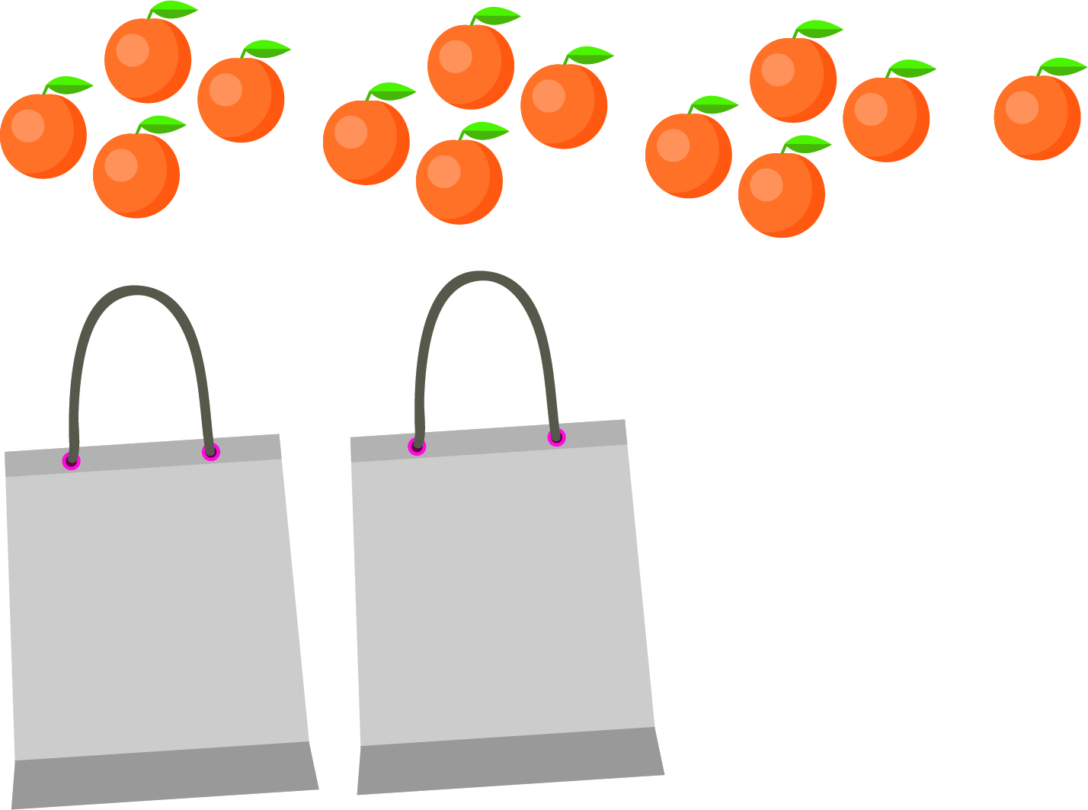

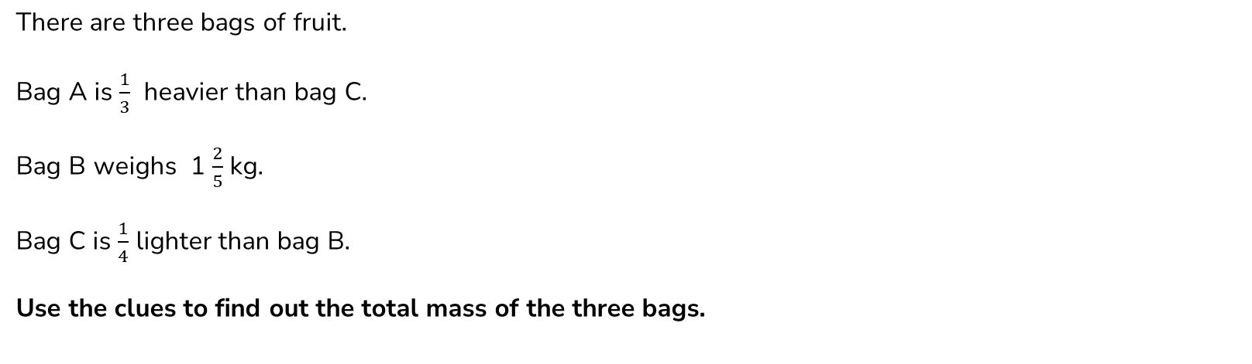
bags of fruit
There are three bags of fruit.
Bag A is $\frac{1}{3}$ heavier than bag C.
Bag B weighs 1 $\frac{2}{5}$ kg.
Bag C is $\frac{1}{4}$ lighter than bag B.
Use the clues to find out the total mass of the three bags.
Notes:
Solution on next slide.

Slide 47
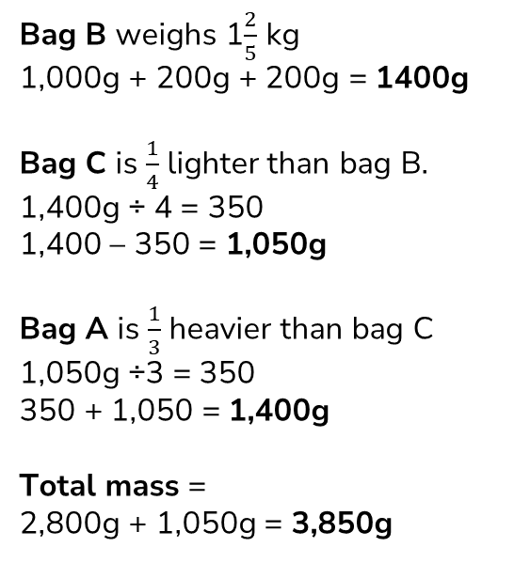
bags of fruit - solution
Bag B weighs 1$\frac{2}{5}$ kg
1,000g + 200g + 200g = 1400g
Bag C is $\frac{1}{4}$ lighter than bag B.
1,400g ÷ 4 = 350
1,400 – 350 = 1,050g
Bag A is $\frac{1}{3}$ heavier than bag C
1,050g ÷3 = 350
350 + 1,050 = 1,400g
Total mass =
2,800g + 1,050g = 3,850g

Slide 48
HFL EDUCATION
HFL Education (formerly Herts for Learning) is a not-for-profit organisation providing all the services, training and resources needed to deliver a great education to every child, to help them flourish and reach their full potential.
With hundreds of advisers and subject experts in house, HFL Education is a trusted partner to education and learning professionals across the country, providing a unique and comprehensive offer to every school and setting – all in one place.
Learn more about us by visiting our website.
Unlock the potential of primary maths education with our Primary Maths Teaching and Learning Team. Get in touch at primarymaths@hfleducation.org.

