Slide 1
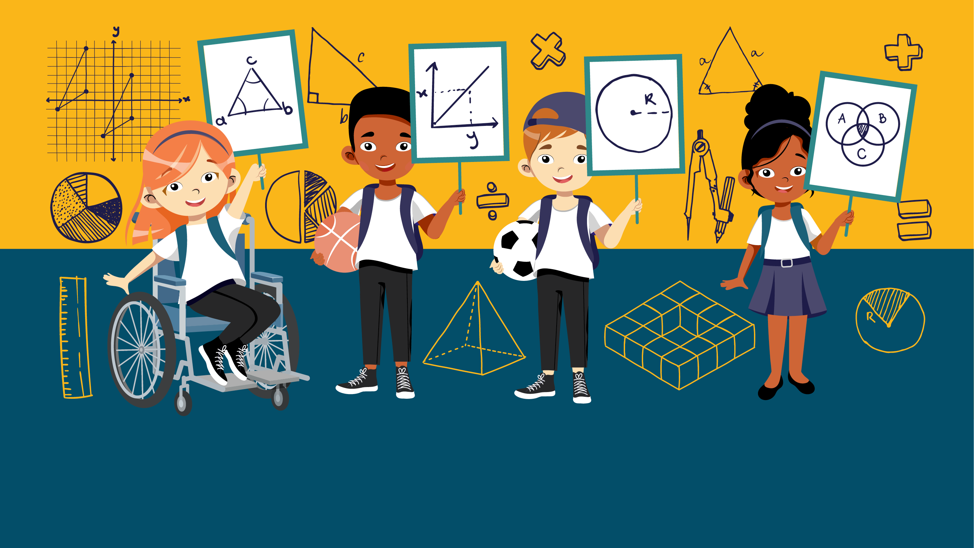
HFL EDUCATION YEAR 6 MATHS CHALLENGE

Slide 2
Round 1 & round 4
PRACTICE QUESTIONS
GENERAL MATHEMATICS QUESTIONS

Slide 3
Six identical right-angles triangles fit inside a rectangle.
The rectangle measures 18cm by 21cm.
What is the shaded area?
18cm
(not drawn to scale)
21cm
Notes:
Each triangle has a height of 9cm (18 ÷ 2 )
Each triangle has a base of 3cm (21-18)
Area of each triangle = 9 x 3 =27 27/2= 13.5
13.5 x 6= 81

Slide 4
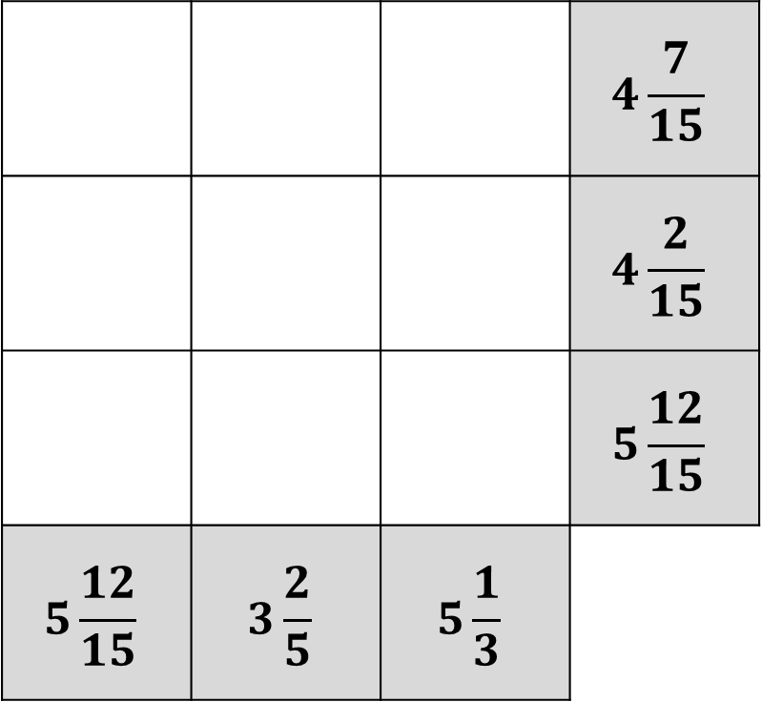
What is the value of ?
 |  |  | $$4\frac{7}{15}$$
 |  |  | $$4\frac{2}{15}$$
 |  |  | $$5\frac{12}{15}$$
$$5\frac{12}{15}$$ | $$3\frac{2}{5}$$ | $$5\frac{1}{3}$$
Notes:
Square = 1 2/15
Circle = 2 1/3
Pentagon = 2/3

Slide 5
Miss McKay likes to line her class up in different ways.
When all the pupils are there, she can line them up in twos, or in threes or in fives, with nobody left over.
What number of children could she have in her class for that to be true?
A) 20
B) 25
C) 30
D) 24
Notes:
30

Slide 6


Last year, Stevie was 7 times older than her brother Jason.
This year, Stevie is 5 times older than Jason.
In how many years will Stevie be 3 times Jason’s age?
Notes:
Answer: 3 years
Solution: last years age is a multiple of 7 and this years age is a multiple of 5- only solution below 100 is 14 and 15.
14 x 2 and 15 x 3 so in three years, Jason will be 6 and Stevie will be 18.

Slide 7
Multiple choice
When divided into 6371, which set of numbers each have a remainder of 1?
2,3,4
3,4,6
2,5,7
5,7,9
Notes:
Answer: C
6371/2=3185r1
6371/5=1274r1
6371/7=910r1

Slide 8
When this prime number square is completed, the eight circles contain different prime numbers.
Each of the four sides has a total of 43.
Complete the square.
23
13
29
Notes:
Solution:
23 7 13
17 19
3 29 11

Slide 9
In this addition calculation,
each letter represents a different non-zero digit.
What is the value of E?
 | B | E | E
+ | B | E | E
H | E | L | P
Notes:
8 7 7 +
8 7 7
1 7 5 4

Slide 10
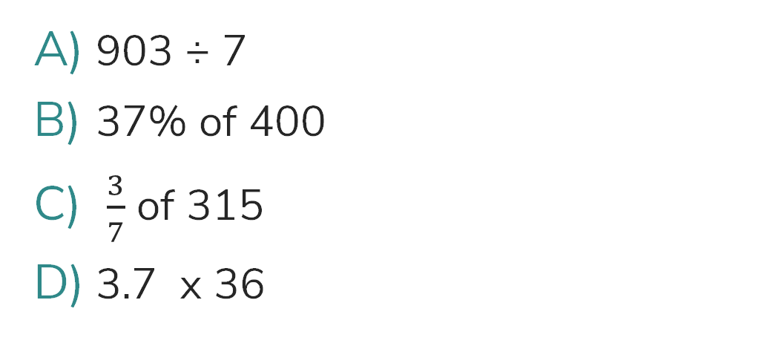
Put these values in order, starting from the smallest answer.
(answer in the form A, B, C, D)
903 ÷ 7
37% of 400
$\frac{3}{7}$ of 315
3.7 x 36
Notes:
A) 129
B) 148
C) 135
D) 133.2
A, D, C, B

Slide 11
Round 2
PRACTICE QUESTIONS
THE ESTIMATION ROUND

Slide 12
On the next slide, there are some weights.
You will have 20 seconds to look at the weights. Remember as much information as you can.
Then, the weights will disappear, and you will have 1 minute to calculate your estimation of the total weight.
1kg
5kg

Slide 13
1kg
1kg
1kg
1kg
1kg
1kg
1kg
1kg
1kg
5kg
5kg
5kg
1kg
1kg
5kg
5kg
5kg
1kg
1kg
1kg
1kg
1kg
1kg
1kg
1kg
1kg
1kg
1kg
1kg
1kg
1kg
1kg
1kg
1kg
1kg
5kg
5kg
5kg
1kg
1kg
5kg
5kg
5kg
1kg
1kg
1kg
1kg
1kg
1kg
1kg
1kg
1kg
1kg
1kg
1kg
1kg
1kg
1kg
1kg
1kg
5kg
5kg
5kg
1kg
1kg
5kg
5kg
5kg
1kg
1kg
1kg
1kg
1kg
1kg
1kg
1kg
1kg
1kg
Notes:
10 x 1kg
3 x 5kg
Per cluster
6 x 25kg =150kg

Slide 14
Estimate the total of all the weights.
You have 1 minute.

Slide 15
Estimate the size of each angle.
a
b
Notes:
148

Slide 16

The area of the triangle is $6{cm}^{2}.$
Estimate the area of the rectangle.
Notes:
Rectangle = 390cm2
Triangle = 3x4 so area = 6cm2
So 65 triangles

Slide 17
Round 3
PRACTICE QUESTIONS
COMPLEX CONUNDRUMS

Slide 18
rules
Teams should complete this round in school BEFORE THEIR HEAT.
There is a time limit of 30 minutes for this round.
Teams should be provided with all 3 conundrums at the same time.
Teams can choose to solve the conundrums in any order.
Teams can decide how long they spend tackling each conundrum but must agree their final answers within the 30-minute time limit.
Points will be awarded for correct answers and part answers.
Conundrum | Maximum marks available
A | 10
B | 15
C | 20

Slide 19
Complex Conundrum A
(practice)
10 points
Find the missing angles.
79°
167°
d°
e°
116°
a°
c°
68°
84°
b°
118°
Notes:
A = 54
B = 72
C = 24
D = 28
E = 77

Slide 20
Solution
79°
167°
77°
116°
54°
28°
24°
68°
84°
72°
118°

Slide 21



Complex Conundrum B
(practice)
15 points
Turquoise paint can be made by mixing:
0.05L of yellow paint
375ml of blue paint
1.2L of green paint
Rita and James want to make some of this turquoise paint.
They use three quarters of a 10L tin of blue paint.
In litres, how much turquoise paint do they make?
Notes:
50ml: 375ml: 1200ml
¾ of 10L = 7500ml
7500/375=20 (multiplier)
50+375+1200=1625
1625 x 20= 32,500ml or 32.5L

Slide 22
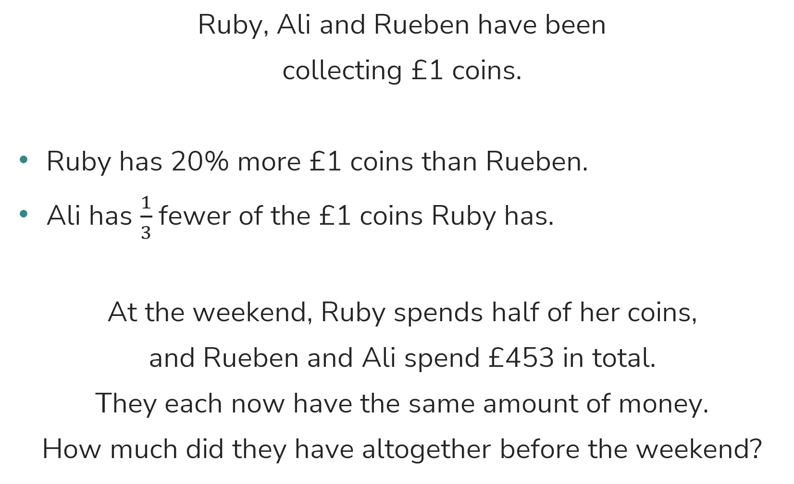
Complex Conundrum C
(practice)
20 points
Ruby, Ali and Rueben have been
collecting £1 coins.
Ruby has 20% more £1 coins than Rueben.
Ali has $\frac{1}{3}$fewer of the £1 coins Ruby has.
At the weekend, Ruby spends half of her coins,
and Rueben and Ali spend £453 in total.
They each now have the same amount of money.
How much did they have altogether before the weekend?
Notes:
£2,265

Slide 23
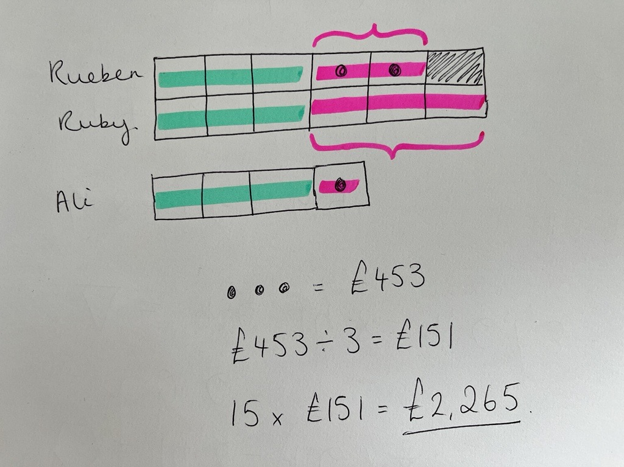
Solution

