Slide 1
Closing The Gap
Briefing: Socio-economic disadvantage
HFL Education
Notes:
Select the slides pertinent to your setting to share with your staff/leadership or governors
Welcome to our Autumn 2 Briefing on Closing The Gap for our Socio Disadvantaged

Slide 2
Eliminating Economic Exclusion
I am a single parent who works part time on low income and due to not receiving certain benefits and my salary being above threshold I am not eligible for any extra financial support.
I have had to use credit cards and borrow money from family to pay for school and extracurricular activities. I do not want my child to miss out so there is pressure to do this.
School costs equate to almost the entirety of our spare income. So as a mother, I go without hobbies or new clothes, to allow my 2 children to take part in all the trips, activities, sports and music lessons on offer.
Notes:
As we head deep into winter, a common theme coming out of our work with schools, settings and trusts around Eliminating Economic Exclusion is the number of families struggling financially with the costs associated with sending their children to school. This extends far beyond those eligible for FSM. Comments like the following from parents are typical of the feedback we are hearing when conducting interviews and surveys.
This could be families in our school community, children, families, staff. Take some time to reflect.
We hope that the practical ideas and suggestions and the inspiring stories are useful to you in your ongoing work to support all children to enjoy and benefit from the full breadth of educational experiences you provide.
As always your feedback (rachel.macfarlane@hfleducation.org) is welcomed.

Slide 3
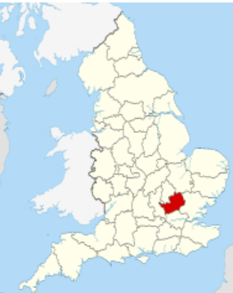
data
At primary, nationally the attainment gap between disadvantaged pupils and their better-off peers stopped growing but it remains far above pre-pandemic levels.
In Hertfordshire, the following tables show the gaps at each key stage are larger than national.
In terms of comparison to other local authorities, Hertfordshire remains in the lowest quintile by most measures; the exceptions being at KS4
Notes:
At primary, nationally the attainment gap between disadvantaged pupils and their better-off peers stopped growing but it remains far above pre-pandemic levels.
In Hertfordshire, the following tables show the gaps at each key stage are larger than national:
In terms of comparison to other local authorities, Hertfordshire remains in the lowest quintile by most measures; the exceptions being at KS4

Slide 4
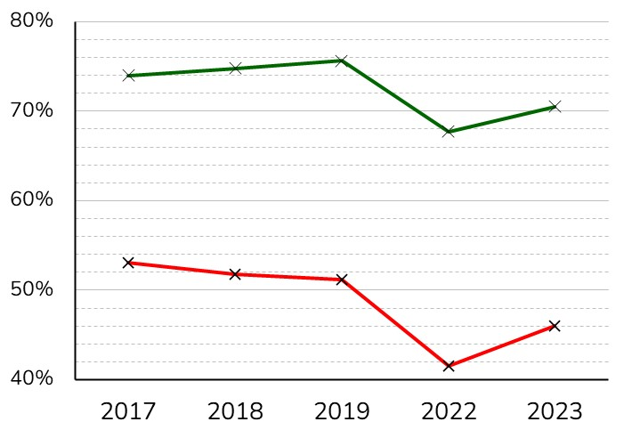
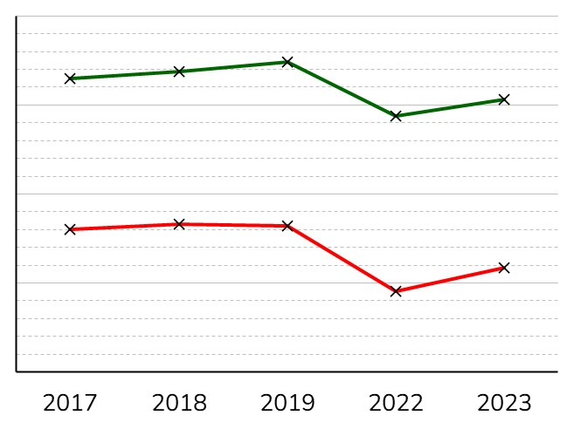
DISADVANTAGED GAP AT EYFS: % GLD
Hertfordshire
National
Non-FSM6
Non-FSM6
% of pupils showing good level of development
FSM6
FSM6
% GLD (Herts)
% GLD (National)
Non-FSM6 | 74% | 75% | 76% | 68% | 71%
FSM6 | 53% | 52% | 51% | 42% | 46%
‘Gap’ (ppt) | –21 | –23 | –24 | –26 | –25
% FSM |  |  | 9.1% | 11.6% | 11.4%
73% | 74% | 75% | 69% | 71%
56% | 57% | 56% | 49% | 52%
–17 | –17 | –18 | –20 | –19
 |  | 14.2% | 18.3% | 17.5%

Slide 5
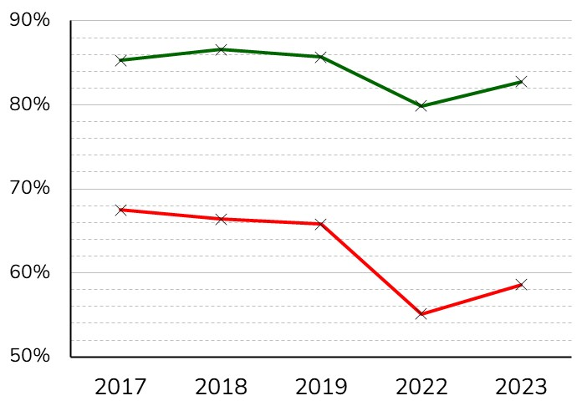
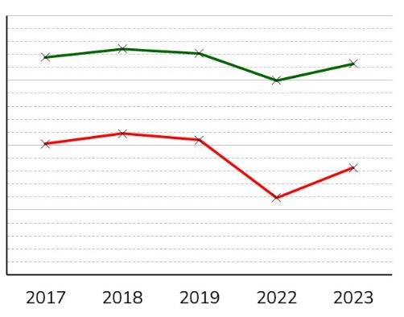
DISADVANTAGED GAP: Y1 PHONICS
Hertfordshire
National
Non-FSM
Non-FSM
% of pupils in Year 1 passing Phonics screening test
FSM
FSM
% GLD (Herts)
% GLD (National)
Non-FSM | 74% | 75% | 76% | 68% | 71%
FSM | 53% | 52% | 51% | 42% | 46%
‘Gap’ (ppt) | –21 | –23 | –24 | –26 | –25
73% | 74% | 75% | 69% | 71%
56% | 57% | 56% | 49% | 52%
–17 | –17 | –18 | –20 | –19

Slide 6
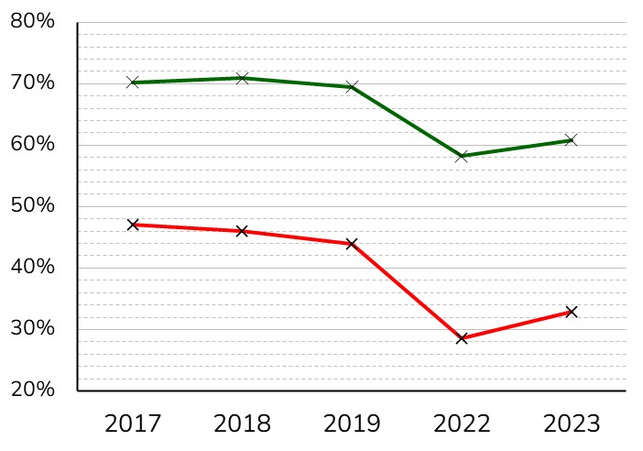
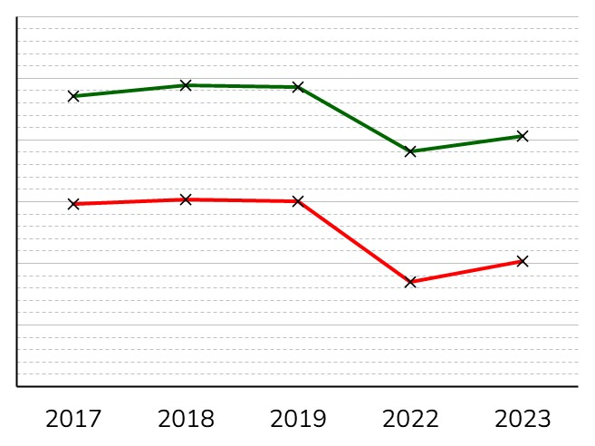
DISADVANTAGED GAP AT KS1: % EXS IN RWM
Hertfordshire
National
Non-FSM6
Non-FSM6
% of pupils reaching expected standard in RWM at KS1
FSM6
FSM6
Non-FSM6 | 70% | 71% | 70% | 58% | 61%
FSM6 | 47% | 46% | 44% | 29% | 33%
‘Gap’ (ppt) | –23 | –25 | –26 | –30 | –28
% FSM |  |  | 13.1% | 14.8% | 15.4%
67% | 69% | 69% | 58% | 61%
50% | 50% | 50% | 37% | 40%
–18 | –19 | –19 | –21 | –20
 |  | 20.0% | 22.4% | 22.7%
% EXS in RWM (Herts)
% EXS in RWM (National)

Slide 7
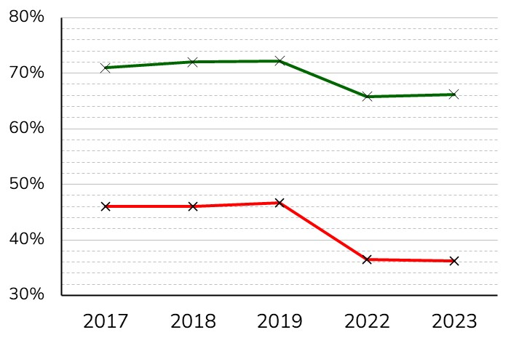
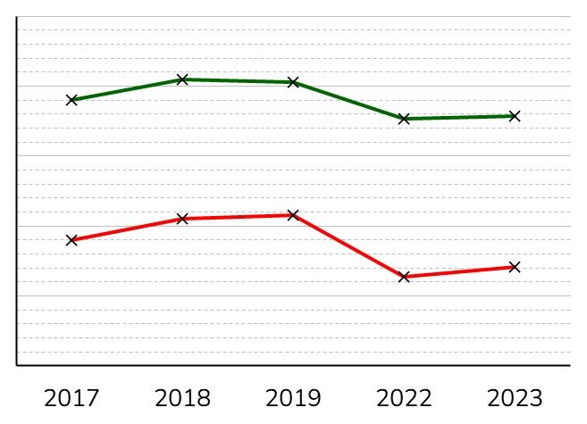
DISADVANTAGED GAP AT KS2: % EXS IN RWM
Hertfordshire
National
Non-FSM6
Non-FSM6
% of pupils reaching expected standard in RWM at KS2
FSM6
FSM6
68% | 71% | 71% | 65% | 65%
48% | 51% | 52% | 43% | 44%
–20 | –20 | –19 | –23 | –22
 |  | 30.0% | 29.1% | 27.9%
% EXS in RWM (Herts)
% EXS in RWM (National)
Non-FSM6 | 71% | 72% | 72% | 66% | 66%
FSM6 | 46% | 46% | 47% | 37% | 36%
‘Gap’ (ppt) | –25 | –26 | –26 | –29 | –30
% FSM |  |  | 20.5% | 19.0% | 20.2%

Slide 8
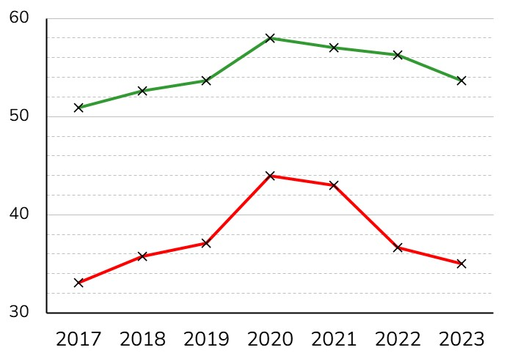
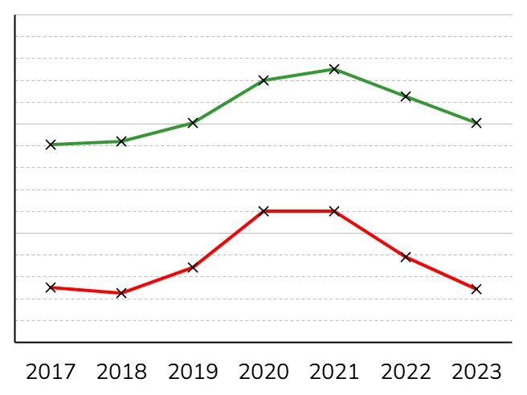
DISADVANTAGED GAP AT KS4: ATTAINMENT 8
Hertfordshire
National
Non-FSM6
Non-FSM6
Attainment 8
FSM6
FSM6
A8 (National)
A8 (Herts)
 |  |  | * | *
48.2 | 48.4 | 50.1 | 54 | 55 | 52.5 | 50.1
35.1 | 34.5 | 36.9 | 42 | 42 | 37.8 | 34.8
–13.1 | –13.9 | –13.2 | –12 | –13 | –14.7 | –15.2
 |  |  |  | * | *
Non-FSM6 | 50.9 | 52.6 | 53.7 | 58 | 57 | 56.3 | 53.7
FSM6 | 33.1 | 35.7 | 37.1 | 44 | 43 | 36.7 | 35.0
‘Gap’ | –17.8 | –16.9 | –16.6 | –14 | –14 | –19.6 | –18.7

Slide 9
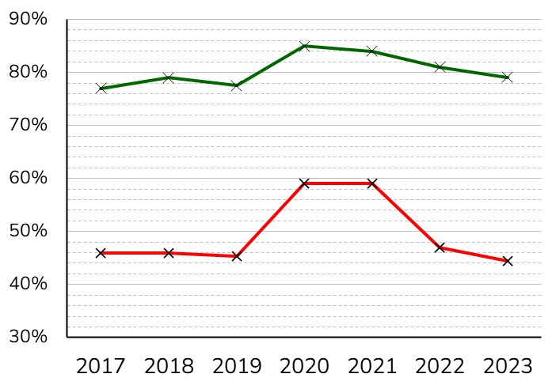
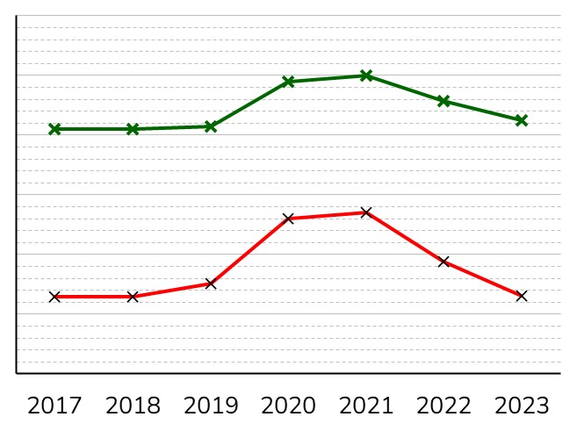
DISADVANTAGED GAP AT KS4: GRADE 4+ IN En/Ma
Hertfordshire
National
Non-FSM6
Non-FSM6
% of students gaining
Grade 4+ in English and Maths
FSM6
FSM6
 |  |  |  | * | *
Non-FSM6 | 77% | 79% | 78% | 85% | 84% | 81% | 80%
FSM6 | 46% | 46% | 45% | 59% | 59% | 47% | 47%
‘Gap’ (ppt) | –31 | –33 | –32 | –26 | –25 | –34 | –35
 |  |  | * | *
71% | 71% | 71% | 79% | 80% | 76% | 73%
43% | 43% | 45% | 56% | 57% | 49% | 43%
–28 | –28 | –26 | –23 | –23 | –27 | –29
4+ En/Ma (Herts)
4+ En/Ma (National)

Slide 10
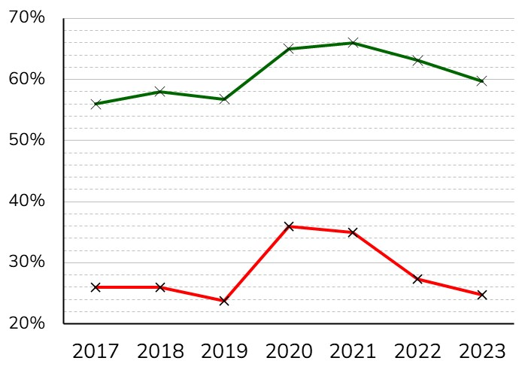
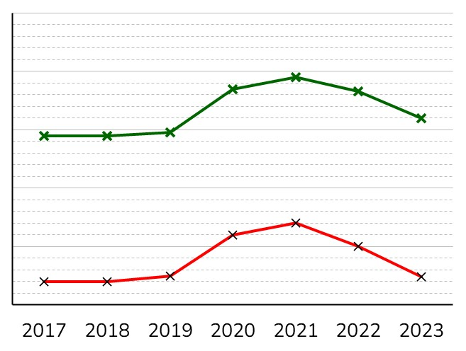
DISADVANTAGED GAP AT KS4: GRADE 5+ IN En/Ma
Hertfordshire
National
Non-FSM6
Non-FSM6
% of students gaining
Grade 5+ in English and Maths
FSM6
FSM6
 |  |  |  | * | *
Non-FSM6 | 56% | 58% | 57% | 65% | 66% | 63% | 61%
FSM6 | 26% | 26% | 24% | 36% | 35% | 27% | 27%
‘Gap’ (ppt) | –30 | –32 | –33 | –29 | –31 | –36 | –34
 |  |  | * | *
49% | 49% | 50% | 57% | 59% | 57% | 52.0
24% | 24% | 25% | 32% | 34% | 30% | 24.8
–25 | –25 | –25 | –25 | –25 | –27 | –27
5+ En/Ma (Herts)
5+ En/Ma (National)

Slide 11

Roots federation nursery
https://www.rootsfederation.herts.sch.uk/
Link to blog:Roots Federation Nursery
Read the following case study. What are your thoughts/takeaways?
Notes:
Choose to read Nursery/Secondary or both with your team.
Practice share/ what are your thoughts?

Slide 12

Marlborough School (Secondary)
https://www.themarlboroughscienceacademy.co.uk/#
Link to blog: Marlborough .docx
Read the following case study. What are your thoughts/takeaways?
Notes:
Practice share/ what are your thoughts?

Slide 13

Book review
Jean Gross is an expert on the causes of underachievement and strategies to close attainment gaps. She has years of experience working with disadvantaged communities Jean is a specialist in SEND and is a qualified Educational Psychologist. The books is full of practical strategies and examples of inspiring practice from a range of schools and settings up and down the country. In the early chapters, Jean explores the data, theory and research around the gap. She then goes on to devote a chapter each to considering the word gap, the literacy gap, the maths gap, behaviour, SEAL (social and emotional aspects of learning) and successful parental engagement. There are references to useful resources and organisations supporting teachers and families.
Arguably the most powerful section of the book is the chapter about self-efficacy. Gross presents a compelling argument that underserved learners feel that the locus of control of their lives lies outside of them and gives some excellent advice for educators as to how to build the self-efficacy of their pupils to enable them to become more confident and powerful learners.
Notes:
*Jean Gross is one of our keynote speakers at the HFL Better Serving Underserved Learners Conference on 17th January 2024. You can get your tickets for this event here: add slide with QR Code

Slide 14

Book your place

Slide 15
Question
Do you have any advice to support a family which is just about managing financially but needs help to pay for prescriptions? The parent has been prescribed three items each month, which total of £38. To give you some background, the parent believes they are not entitled to free prescriptions and this injury could take up to six months to heal.
Notes:
Take one of the questions that is pertinent to your school from the Q and A slides to discuss as a group and then share the possible answers.

Slide 16
Possible solution
The NHS offer a Prescription Pre-payment Certificate (PCC) link here The certificate covers all NHS prescriptions for a set price, so although there is an initial outlay, the family will save money if, as you have suggested, they need more than 3 items in 3 moths, or 11 items in 12 months.
The prescription charge in England is £9.65 per item. A PPC costs: £31.25 for 3 months or £111.60 for 12 months.
It would be worth advising the parent to check to see if they are entitled to free NHS prescriptions using the eligibility checker.

Slide 17
Question
At my school, we subsidise trips for parents of pupils eligible for Free School Meals but we know that there are parents who are not eligible who cannot afford to pay trip costs. What can we do to support them?
Notes:
At my school, we subsidise trips for parents of pupils eligible for Free School Meals but we know that there are parents who are not eligible who cannot afford to pay trip costs. What can we do to support them?
The findings from our EEE reviews show clearly that there are many parents across the county who are really struggling to make ends meet, for whom enrichment and trip cost present a great challenge. We even heard from one mother who had taken out a bank loan to pay for trip expenses. Some schools are letting parents know what a trip costs per pupil but then encouraging anyone who has the capacity to pay extra to support another child to do so. Online payment systems make this easy and non-conspicuous to action, The school then adds these funds to a JAM or Hardship fund and administers subsidies to parents not the PP register as requests come in/ they become aware of hardship cases. Other miscellaneous donations to the school can also be added to the Hardship fund.
We have a wonderful PTA at our school. The parents who run it give so much time to support the pupils and they are always thinking up new ideas for fundraising to help the school budget. But I’m worried that not all families are able to access the events they run due to the costs. The other week, they put on a disco for Year 7s to help them settle in. But it cost £6 and then snacks and drinks were charged on top of that. I don’t want to dampen their enthusiasm and the extra funds are really useful. What do you advise?
This is a sensitive area. It’s great that you have parents giving freely of their time and it sounds like they are organising some really enriching experiences and events. But it sounds like they might be so keen to raise funds that they are not considering the challenging financial position that many parents find themselves in. This is important as they exist to represent ALL families.
How many of our PTA members are eligible for PP funding themselves? If the answer is none, you might like to give some thought as to how you can encourage less economically advantaged parents to come forward and serve on the PTA so that the voice of families like theirs can be heard.
Did you keep a register of the Year 7s who attended the disco? If you did, and those from economically-disadvantaged families were underrepresented, why not share the figures with the PTA as a means of opening up a discussion. Clearly their aim was to help the new pupils settle in and make new friends; if a certain percentage of the cohort was priced out of the event, the discos did not fulfil its aim of inclusion.
As head, you could make it very clear to the PTA that your challenge to them is to organise fully inclusive events, with a great uptake from underserved learners and that you will be gauging the success of the activity through this lens. (You will, of course, need to be careful not to disclose any confidential personal data to members of the PTA).

Slide 18
Possible solution
The findings from our EEE reviews show clearly that there are many parents across the county who are really struggling to make ends meet, for whom enrichment and trip cost present a great challenge. We even heard from one mother who had taken out a bank loan to pay for trip expenses. Some schools are letting parents know what a trip costs per pupil but then encouraging anyone who has the capacity to pay extra to support another child to do so. Online payment systems make this easy and non-conspicuous to action, The school then adds these funds to a JAM or Hardship fund and administers subsidies to parents not the PP register as requests come in/ they become aware of hardship cases. Other miscellaneous donations to the school can also be added to the Hardship fund.

Slide 19
Question
We have a wonderful PTA at our school. The parents who run it give so much time to support the pupils and they are always thinking up new ideas for fundraising to help the school budget. But I’m worried that not all families are able to access the events they run due to the costs. The other week, they put on a disco for Year 7s to help them settle in. But it cost £6 and then snacks and drinks were charged on top of that. I don’t want to dampen their enthusiasm and the extra funds are really useful. What do you advise?
Notes:
We have a wonderful PTA at our school. The parents who run it give so much time to support the pupils and they are always thinking up new ideas for fundraising to help the school budget. But I’m worried that not all families are able to access the events they run due to the costs. The other week, they put on a disco for Year 7s to help them settle in. But it cost £6 and then snacks and drinks were charged on top of that. I don’t want to dampen their enthusiasm and the extra funds are really useful. What do you advise?
This is a sensitive area. It’s great that you have parents giving freely of their time and it sounds like they are organising some really enriching experiences and events. But it sounds like they might be so keen to raise funds that they are not considering the challenging financial position that many parents find themselves in. This is important as they exist to represent ALL families.
How many of our PTA members are eligible for PP funding themselves? If the answer is none, you might like to give some thought as to how you can encourage less economically advantaged parents to come forward and serve on the PTA so that the voice of families like theirs can be heard.
Did you keep a register of the Year 7s who attended the disco? If you did, and those from economically-disadvantaged families were underrepresented, why not share the figures with the PTA as a means of opening up a discussion. Clearly their aim was to help the new pupils settle in and make new friends; if a certain percentage of the cohort was priced out of the event, the discos did not fulfil its aim of inclusion.
As head, you could make it very clear to the PTA that your challenge to them is to organise fully inclusive events, with a great uptake from underserved learners and that you will be gauging the success of the activity through this lens. (You will, of course, need to be careful not to disclose any confidential personal data to members of the PTA).

Slide 20
This is a sensitive area. It’s great that you have parents giving freely of their time and it sounds like they are organising some really enriching experiences and events. But it sounds like they might be so keen to raise funds that they are not considering the challenging financial position that many parents find themselves in. This is important as they exist to represent ALL families.
How many of our PTA members are eligible for PP funding themselves? If the answer is none, you might like to give some thought as to how you can encourage less economically advantaged parents to come forward and serve on the PTA so that the voice of families like theirs can be heard.
Did you keep a register of the Year 7s who attended the disco? If you did, and those from economically-disadvantaged families were underrepresented, why not share the figures with the PTA as a means of opening up a discussion. Clearly their aim was to help the new pupils settle in and make new friends; if a certain percentage of the cohort was priced out of the event, the discos did not fulfil its aim of inclusion.
As head, you could make it very clear to the PTA that your challenge to them is to organise fully inclusive events, with a great uptake from underserved learners and that you will be gauging the success of the activity through this lens. (You will, of course, need to be careful not to disclose any confidential personal data to members of the PTA).

Slide 21
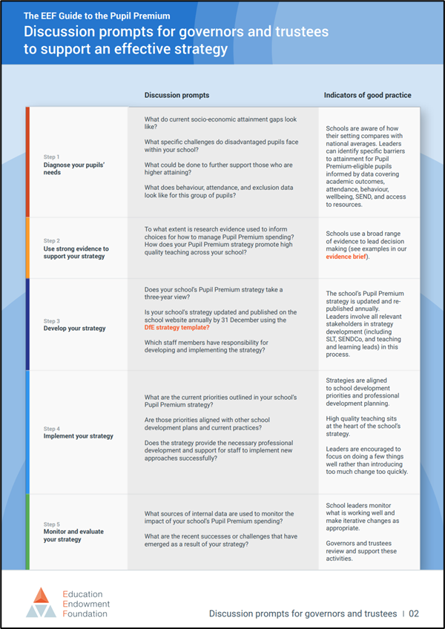
Governance: leadership
(The Governance Handbook)
discussion prompts for governors and trustees.
Widening the Lens
Widening the lens on disadvantage
Poverty Toolkit
Notes:
Governing boards have a crucial role to play in ensuring that pupils in their schools and trusts who are economically disadvantaged receive the support they need to achieve great outcomes. Governors and trustees are expected to “consider how the school is going to raise standards for all children … [including] … those receiving free school meals and those who are more broadly disadvantaged.” (The Governance Handbook)
We have recently come across two sets of resources that we think are useful in providing support for governors and trustees in doing this.
The Education Endowment Fund (EEF)’s recently updated Pupil Premium resources now include discussion prompts for governors and trustees. These are designed to help governing boards champion strategic Pupil Premium spending by asking questions and initiating purposeful discussions. They follow the EEF’s five-point plan around devising an effective Pupil Premium strategy (diagnosing, planning, monitoring, implementing, and sustaining).
The National Governance Association (NGA) has produced a suite of resources called Widening the Lens to support governors and trustees in exploring what disadvantage means in their context and in identifying pupil groups who may need additional support. The Widening the lens on disadvantage guidance includes ‘25 Top Tips for addressing educational disadvantage’, developed from the work of Marc Rowland. The Poverty Toolkit has been produced in conjunction with the Child Poverty Action Group, and provides governing boards with a wealth of resources to use to ensure that all school leaders are considering how poverty in its broadest sense, beyond pupil premium eligibility, impacts their school or trust community.

