Slide 1


MACHINE MALFUNCTION! – KS1
3
4
5
6
5
7
9
11
Instead of wrapping up the numbers in festive paper, the machine has changed each number.
3 has become 5.
6 has become 11.
The machine is doing two calculations to each number.
Which two calculations does the machine make to change each number?
Notes:
Double subtract 1

Slide 2
MACHINE MALFUNCTION! – KS2
7
9
10
11
35
49
56
63
Instead of wrapping up the numbers in festive paper, the machine has changed each number.
7 has become 35.
11 has become 63.
The machine is doing two calculations to each number.
Which two calculations does the machine make to change each number?
Notes:
Subtract 2, multiply by 7

Slide 3

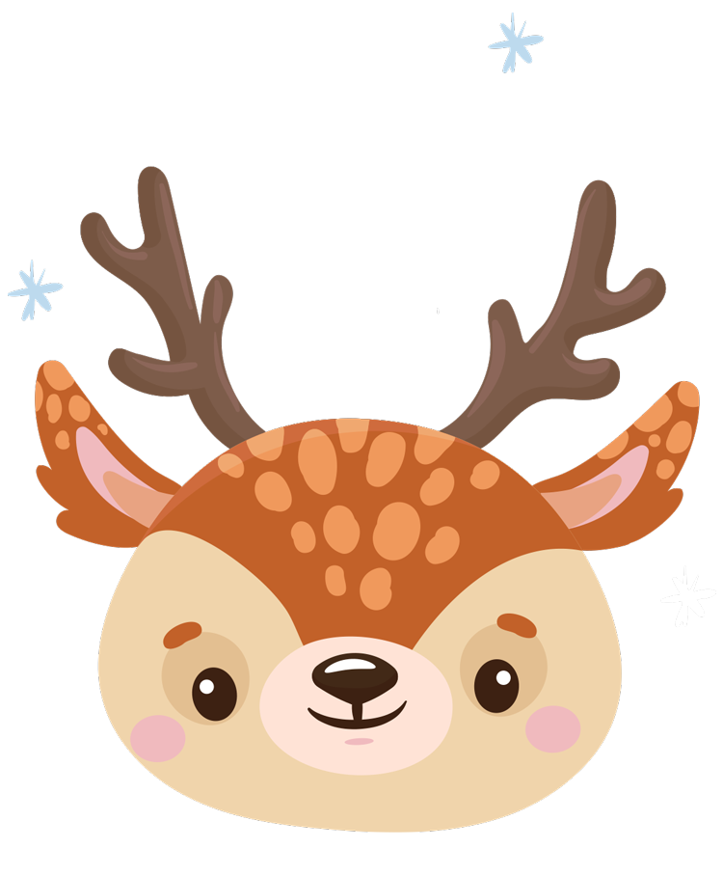
Reindeer Herding
The reindeer herder wants to add fences to the enclosure so that there are 2 separate parts. In each enclosure, there should be an even number of reindeer.
How many ways can the herder do this?
If the herder wanted 1 group to be an even number of reindeer and 1 group to be an odd number, is this possible? Why? Why not?

Slide 4


Mirror magic
What do you notice about the picture of the reindeer?
Can you see it has one line of vertical symmetry?
What could a snowman with a line of symmetry look like? What about a snowflake? Or a penguin?
What different designs can you create?
Can you draw a festive picture with more than 1 line of symmetry?

Slide 5

Polar postie’s Problem 1
The polar posties are sorting through letters.
They need to arrange the envelopes so that the house numbers in each row and column add up to 12.
Using the numbers 1 to 8, can you arrange the envelopes so that each row and column total 12?
Some numbers may appear more than once.
Some numbers may not appear at all!
Is there more than 1 way to arrange the numbers?

Slide 6
Polar postie’s Problem 2
The polar posties are sorting through letters to deliver to Decimal Street.
They need to arrange the envelopes so that the house numbers in each row and column add up to 1.2.
Using the numbers 0.1 to 0.8, can you arrange the envelopes so that each row and column total 1.2?
Some numbers may appear more than once.
Some numbers may not appear at all!
Is there more than 1 way to arrange the numbers?

Slide 7

Penguin Parcels
Three penguins were wrapping up 23 gifts.
Each penguin wrapped up an odd number of gifts.
Each penguin wrapped up a different number of gifts.
How many gifts did each penguin wrap up?
How many different possibilities are there?

Slide 8

We will be awarding a prize for the best response to each task: a picture, model, written response or something else!
To enter, please reply with a photo of the solution.
@hertsmaths #HFL_FESTIVE5
FESTIVE 5
The closing date for entries is 31st December.
Prizes will be awarded and sent out in January.

Slide 9
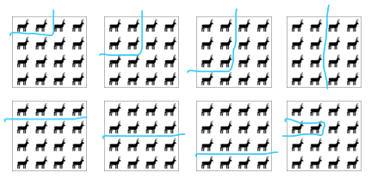
FESTIVE FIVE 2023 - EXAMPLE SOLUTIONS
Reindeer herding
Solutions include the following:
Machine Malfunction KS1
Machine Malfunction KS2
Rule: double the number and then subtract 1
Children may include additional variations.
Rule: subtract 2 and then multiply by 7
Mirror magic
The herder cannot group the reindeer into 1 odd and 1 even group.
The children should generalise that an odd + even would give an odd total of reindeer. Children could use models and drawings to justify this.
Symmetrical pictures to be created by the children.

Slide 10
FESTIVE FIVE 2023 - EXAMPLE SOLUTIONS
Penguin parcels
Polar Posties problem 1 and 2
Solutions could include:
There are 8 possible combinations.
1, 3, 19
1, 5, 17
1, 7, 15
1, 9, 13
3, 5, 15
3, 7, 13
3, 9, 11
5, 7, 11
2 | 7 | 3
2 | 4 | 6
8 | 1 | 3
8 | 1 | 3
3 | 5 | 4
1 | 6 | 5
0.2 | 0.7 | 0.3
0.2 | 0.4 | 0.6
0.8 | 0.1 | 0.3
0.8 | 0.1 | 0.3
0.3 | 0.5 | 0.4
0.1 | 0.6 | 0.5

Slide 11
