Slide 1
Round 1 & round 4 PRACTICE QUESTIONS
GENERAL MATHEMATICS QUESTIONS

Slide 2
Order these from the calculation with the largest value
to the calculation with the smallest value.
(answer in the form of D, B, A, C)
1$\frac{2}{8}$ – $\frac{3}{8}$
2$\frac{4}{8}$ – $\frac{6}{8}$
$\frac{3}{8}$ + $\frac{5}{8}$
$\frac{6}{8}$ + $\frac{5}{8}$
Notes:
A) 7/8
B) 14/8 or 1 6/8
C) 8/8 or 1
D) 11/8 or 1 3/8
B, D, C, A

Slide 3
Which of these numbers has the most factors?
24
30
36
47
Notes:
24 – 1, 2, 3, 4, 6, 8, 12, 24
30 – 1, 2, 3, 5, 6, 10, 15, 30
36 – 1, 2, 3, 4, 6, 9, 12, 18, 36
47 – 1, 47

Slide 4
What is the combined value of the coins
collected by the children?
20p coins
50p coins
Notes:
Ahmed:
12 x 20p coins = £2.40
13 x 50p coins = £6.50
Total: £8.90
Jasper:
15 x 20p coins = £3.00
18 x 50p coins = £9.00
Total: £12.00
Combined value = £20.90

Slide 5
Put these in order, starting with the smallest answer.
(answer in the form of D, B, A, C)
2308 + 4699
7100 ÷ 1
8003 – 3079
825 x 9
Notes:
A) 7,007
B) 7,100
C) 4,924
D) 7,425
C, A, B, D

Slide 6
The perimeter of
this shape is 48cm.
What is the perimeter of
this shape?
Notes:
22 x 8 = 176cm

Slide 7
The same digit is hidden by the squares.
What is the digit?
 | 6 | ? | 8 | 1
- | ? | 4 | 6 | 9
 | 3 | 8 | 1 | ?
Notes:
6281 – 2469 = 3812
Missing digit – 2

Slide 8
A shop has a sale on.
Buy 1 box of cupcakes and get a 2nd box for $\frac{1}{3}$ of the price.
Leni buys this box of cupcakes
and gets another box in the sale.
What is the cost per cupcake?
£18
Notes:
£18 + £6 = £24
Cost per cupcake = £1

Slide 9
B
A
C
Which shape has the most lines of symmetry?
Answer using the shape letter.
D
F
E
Notes:
Lines of symmetry:
A has 1
B has 5
C has 3
D has 0
E has 2
F has 1
B has the most.

Slide 10
Round 2 PRACTICE QUESTIONS
THE ESTIMATION ROUND

Slide 11
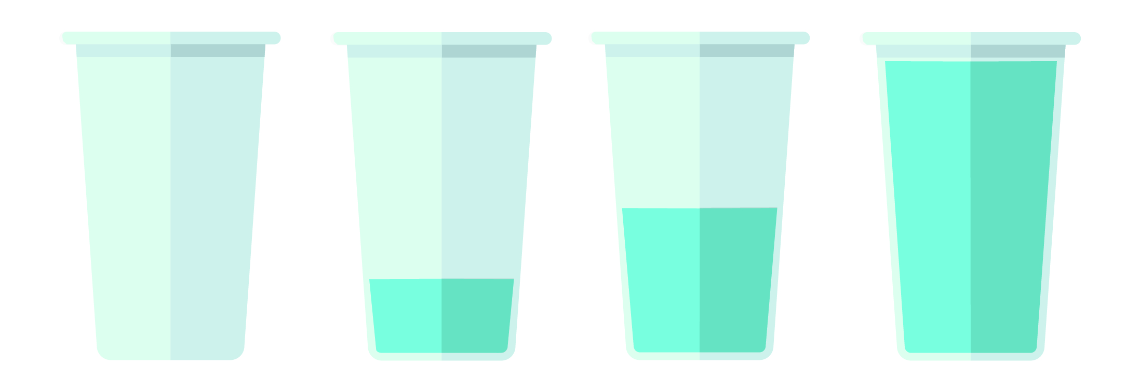
Estimate how much water is in all 4 glasses altogether.
125ml
Notes:
Cup 1 = 0 ml
Cup 2 = approx. 60 ml
Cup 3 = 125 ml
Cup 4 = approx. 260 ml
Approx total = 445 ml

Slide 12
2.46
What is the value at point W on this zigzag number line?
2.63
154
W
P
Notes:
W = approx. 2.97

Slide 13
Round 3 (PRE-ROUND) PRACTICE QUESTION
SPOT THAT SHAPE!

Slide 14
How many quadrilaterals are in the picture?

Slide 15
How many quadrilaterals are in the picture?
F
J
E
A – B – G – F – A
A- B – J – F – A
A – B – H – G – A
A – B – H – F – A
A – B – C – G – A
A – B – C – F – A
A – G – J – F – A
A – I – E – F – A
B – C – D – I – B
B – I – E – J – B
C – D – I – H – C
C – D – I – G – C
I – E – J – G – I
I – E – F – G – I
I
G
A
H
D
B
C
There are 14 quadrilaterals in the picture.

Slide 16
How many quadrilaterals are in the picture?
There are 14 quadrilaterals
in the picture.

