Slide 1
THE HEATS

Slide 2
Questions and answers
The following questions are from the Year 3 maths challenge 2023 heats.
Answers to the questions are below each slide in the notes.

Slide 3
Round 1
GENERAL MATHEMATICS QUESTIONS
Notes:
5 Qs
I will show on screen and read it you.
Then you will have 2 minutes per question.
I will give you a final few seconds warning to agree your answer before the screen goes blank.
When it goes blank – get ready for the next question.
And remember, if unsure have a good guess.
So question 1…….

Slide 4
Round 1
Question 1
The same digit is hidden by the paint splodges.
What is the digit?
1 | 8 | + | 1 | 8 | + | 3 | 0 | 8 | = | 3 | 4 | 4
Notes:
18 + 18 + 308 = 344
Missing digit – 8

Slide 6
Round 1
Question 2
What two calculations does the robot do?
4
5
6
7
?
17
21
25
29
?
Notes:
x4+1

Slide 8
Round 1
Question 3
Jack is thinking of a whole number.
He multiplies it by 5,
then adds 7
and doubles it.
He arrives at 64.
What number did Jack first think of?
Notes:
5
5 x 5 = 25
25 + 7 = 32
32 x 2 = 64

Slide 10
Round 1
Question 4
Order these calculations from smallest to largest answer.
(answer in the form of ABCD)
A) 5 x 3 x 2
B) 346 + 285
C) 48 ÷ 4
D) 409 – 283
Notes:
A) 5 x 3 x 2 = 30
B) 346 + 285 = 631
C) 48 divided by 4 = 12
D) 909 – 283 = 626
C, A, D, B

Slide 12
Round 1
Question 5
Look at the sequence of times.
What time would be shown on the 7th clock?
…
Clock 1
Clock 2
Clock 3
Notes:
5 past 5
25 past 5
Quarter to 6
5 past 6
25 past 6
Quarter to 7
07:05 / 19:05

Slide 14
End of round 1

Slide 15
Round 2
ESTIMATION ROUND
Notes:
5 questions
Will explain the Q and then you have 2 minutes to agree your answer.
REMEMBER THIS IS AN ESTIMATION ROUND
SO YOUR ANSWERS DO NOT HAVE TO BE EXACT.
YOU CAN GET FULL MARKS FOR BEING IN THE ‘CLOSE’ RANGE.
MARKS DECREASE AS YOU ARE FURTHER AWAY FROM THIS.
So use what you see on screen as clues. But you will have to do some working out together in the time limit of 2 mins.

Slide 16
Round 2
Question 1
Estimate how many squares are within the larger shape.
Notes:
10 squares in the small shape
48 squares in the larger shape

Slide 18
Round 2
Question 2
Estimate the total value of the coins in pence.
10
PENCE
10
PENCE
10
PENCE
10
PENCE
10
PENCE
10
PENCE
10
PENCE
10
PENCE
10
PENCE
10
PENCE
10
PENCE
10
PENCE
10
PENCE
10
PENCE
10
PENCE
10
PENCE
10
PENCE
10
PENCE
10
PENCE
10
PENCE
10
PENCE
10
PENCE
10
PENCE
10
PENCE
10
PENCE
10
PENCE
10
PENCE
10
PENCE
10
PENCE
10
PENCE
10
PENCE
10
PENCE
10
PENCE
10
PENCE
10
PENCE
10
PENCE
10
PENCE
10
PENCE
10
PENCE
10
PENCE
10
PENCE
10
PENCE
10
PENCE
10
PENCE
10
PENCE
10
PENCE
10
PENCE
10
PENCE
10
PENCE
10
PENCE
10
PENCE
10
PENCE
Notes:
53 coins = 530p

Slide 20
Question 3
Round 2
What number is represented by ?
316
?
326
Notes:
Answer: 347

Slide 22
Question 4
Round 2
Estimate the height of Big Ben’s clock tower.
Big Ben’s clock tower
London, UK
Suurhusen Tower, Germany (27m)
Leaning Tower of Pisa, Italy
Notes:
Total height to the nearest metre:
Suurhusen Tower – 27m
Leaning Tower of Pisa – 57m
Big Ben’s clock tower – 96m

Slide 24
Round 2
Question 5
Here is a picture of an ice cream.
It will appear, disappear and then re-appear.
To the nearest second, estimate for how long it disappears.

Slide 25
Notes:
So here it is now.
It will disappear shortly.
And then reappear.
So remember, the Q is.
For how long did it disappear?

Slide 26
Notes:
So here it is now.
It will disappear shortly.
And then reappear.
So remember, the Q is.
For how long did it disappear?

Slide 28
Notes:
So here it is now.
It will disappear shortly.
And then reappear.
So remember, the Q is.
For how long did it disappear?
56 seconds

Slide 29
End of round 2

Slide 30
Round 3
SPOT THAT SHAPE!
Notes:
Add your answer to your answer sheet
Answer = X squares

Slide 31
The pre-round: ‘Spot the Shape’
• There is one round for pupils to complete before the final. This is the ‘Spot the Shape’ round.
• There is no time limit for this question. We anticipate that it will take around 15 minutes to complete.

Slide 32
Spot that shape!
How many squares are in the picture?

Slide 33
Spot that shape!
How many squares are in the picture?
There are 30 squares in the picture.
16 1x1 squares
4 3x3 squares
9 2x2 squares
1 4x4 square
Notes:
30 squares in total

Slide 34
End of round 3

Slide 35
Round 4
GENERAL MATHEMATICS QUESTIONS
Notes:
5 questions
Will explain the Q and then you have 2 minutes to agree your answer.

Slide 36
Round 4
Question 1
Arrange the fraction cards in increasing order, starting with the smallest.
Write the letters of the cards in order, e.g., ABCD
A
B
C
D
7
2
2
3
8
4
7
4
Notes:
C, B, D, A

Slide 38
Round 4
Question 2
Alex has one of every possible British Sterling coin in his hand.
What is the total value of the coins in his hand, in pence?
Notes:
1p, 2p, 5p, 10p, 20p, 50, £1, £2 £3.88 so 388p

Slide 40
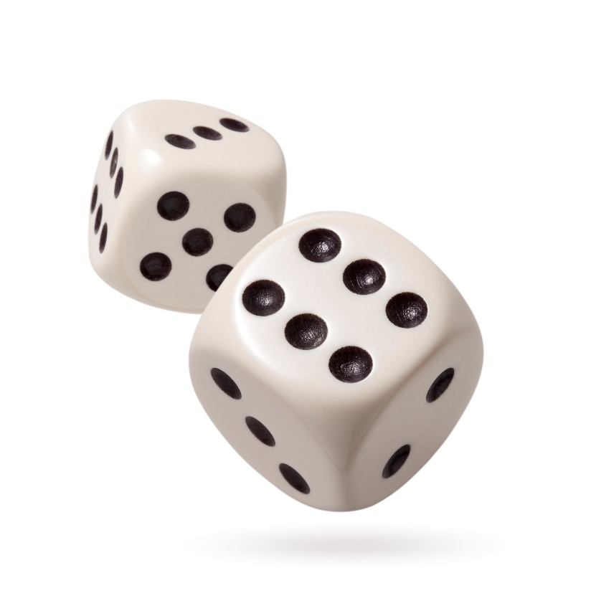
Round 4
Question 3
How many dots are there in total on 11 dice?
Notes:
There are 21 dots on 1 die.
231 dots on 11 dice.

Slide 42
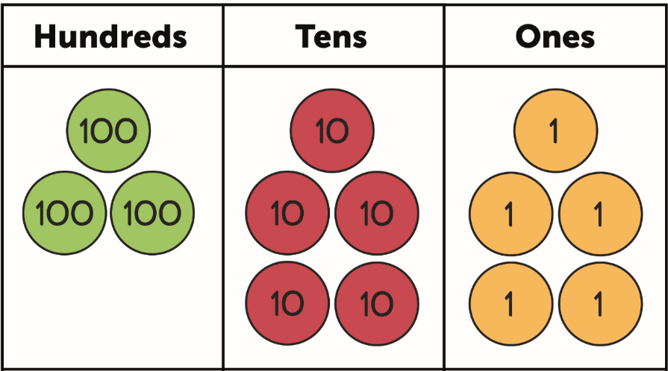
Round 4
Question 4
Suki placed 11 counters on the chart to create a number.
What number did she make?
The 3-digit number was a multiple of 5.
The number of counters in the tens was half the number of counters in the hundreds.
Notes:
425

Slide 44
Round 4
Question 5
If = 90, how many would balance the scale?
Notes:
If circle = 90…
Square = 45
Pentagon = 15
Triangle = 30
3 triangles

Slide 45
End of round 4

Slide 46
Well done Year 3!
Notes:
Thank you once again for taking part.
And thank you to all your supporting adults and teachers.
We hope it has been challenging but also fun.

Slide 47
HFL Education is a leading national provider of school improvement and business support services, training, and resources, which enable schools, educational settings and multi-academy trusts to deliver a great education. We support those we work with to achieve successful long-term outcomes for their children. We believe that every young person, through access to a great education, should be able to realise their potential, regardless of where they live, their background or circumstances.
Learn more about us by visiting our website

