Slide 1
GRAND FINAL

Slide 2
Questions and answers
The following questions are from the Year 3 maths challenge 2023 final.
Answers to the questions are below each slide in the notes.

Slide 3
Round 1
GENERAL MATHEMATICS QUESTIONS

Slide 4
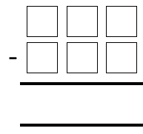
Round 1
Question 1
The same digit is hidden by the paint splodges.
What is the digit?
6
7
3
8
5
6
Notes:
967 – 398 = 569

Slide 6
Round 1
Question 2
Which shaded fraction is NOT equivalent to the others?
A | B | C
D | E | F
Notes:
A B C D and F are all equivalent to one quarter
E has 2 out of 9 parts shaded.

Slide 8
Round 1
Question 3
What two calculations does the robot do?
7
5
6
4
?
61
41
51
31
?
Notes:
x10 - 9

Slide 10
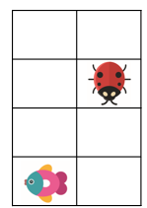
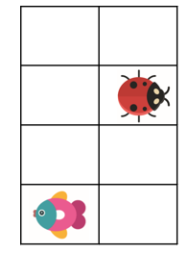
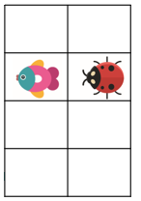
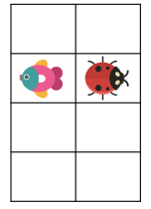
Round 1
Question 4
Here is a pattern. Which card would be next?
?
A
B
C
D
Notes:
B

Slide 12
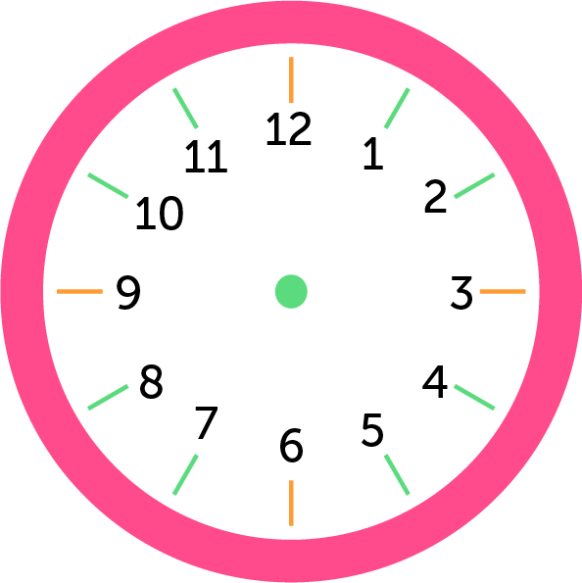
Round 1
Question 5
This clock has lost its minute hand.
Using the hour hand, what time is it?
Notes:
07:45 – points for closeness

Slide 14
End of round 1

Slide 15
Round 2
ESTIMATION ROUND

Slide 16
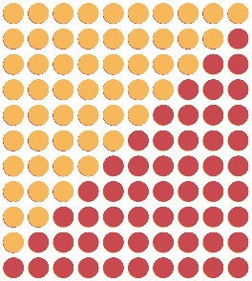
Question 1
Round 2
Estimate the total number of dots shown
Notes:
11 x 10 x 3 x 7
There are 2,310 dots

Slide 17
Question 1
Round 2
Notes:
11 x 10 x 3 x 7
There are 2,310 dots

Slide 19
Question 2
Round 2
What number is represented by P?
79
P
259
Notes:
187

Slide 21
Round 2
Question 3
A standard set of dominos has 28 pieces as shown below.
Estimate the total number of dots.
Notes:
168 dots on a standard set

Slide 23
Question 4
Round 2
Approximately what fraction of this shape is green.
A
B
C
D
2
2
2
2
3
4
6
10
Notes:
F 9 I 9 N13 A12 L 7 = 50 + 25 in each corner = 100 green
The rectangle has an area of 304 squares.
Approximately a third of the shape is green= option C

Slide 25
Round 2
Question 5
Estimate how many small green triangles are needed to cover this board?
8.9 cm × 6.4 cm]
Notes:
Each row would need 28 small triangles
12 rows = 336 triangles in total.

Slide 27
End of round 2

Slide 28
Round 3
SPOT THAT SHAPE!

Slide 29
The pre-round: ‘Spot the Shape’
• There is one round for pupils to complete before the final. This is the ‘Spot the Shape’ round.
• There is no time limit for this question. We anticipate that it will take around 15 minutes to complete.

Slide 30
Spot that shape!
How many quadrilaterals are in the picture?

Slide 31
Spot that shape!
How many quadrilaterals are in the picture?
There are 24 quadrilaterals in the picture.
d
1 outer perimeter shape
5 solo shapes
b, c, f, g, h
10 top row combos
a+b, a+b+c, a+b+c+d, a+b+c+d+e, b+c, b+c+d, b+c+d+e, c+d, c+d+e, d+e
6 bottom row combos
f+g, f+g+h, f+g+h+i, g+h, g+h+i, h+i
2 top & bottom combos
a+f, a+b+f+g+h
c
b
a
e
f
i
g
h
Notes:
24

Slide 32
End of round 3

Slide 33
Round 4
GENERAL MATHEMATICS QUESTIONS

Slide 34
Round 4
Question 1
Think about the numbers 1 to 30 (1, 2, 3… 30).
Arrange these cards in increasing order, starting with the smallest number
A
B
C
D
Numbers greater than 10
Number of odd numbers
Numbers containing the digit 0
Numbers containing the digit 2
Write the letters of the cards in order, e.g., ABCD
Notes:
CDBA
A – 20
B – 15
C – 3
D – 12

Slide 36
Which chain does NOT end on 100?
Round 4
Question 2
A
30 |  | x 3 |  | ÷ 10 |  | +11 |  | X 5
B
100 |  | ÷ 20 |  | + 16 |  | x4 |  | +17
C
5 |  | X 5 |  | X 5 |  | + 9 |  | - 34
D
212 |  | - 99 |  | + 89 |  | X 1 |  | - 102
Notes:
100
101
100
100
B is incorrect as it equals 101

Slide 38
Round 4
Question 3
How many trains would be needed to transport these children?
8 children per train
Notes:
6 x 3 x 4 children = 72 children
72 children divided by 8 = 9

Slide 40
Round 4
Question 4
Which number is being described by these clues?
The sum of my digits is 14 | All my digits are smaller than 7 | I am a multiple of 5
My tens digit is double my hundreds digit | I am an odd number | I am a 3 digit number
Notes:
365

Slide 42
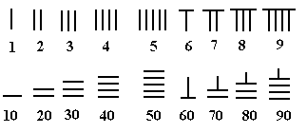
Round 4
Question 5
One of the world’s oldest number systems originated in China.
What is the sum of the numbers in the red box?
Notes:
40 + 8 + 90 = 138

Slide 43
End of round 4

Slide 44
Well done Year 3!

Slide 45
HFL Education is a leading national provider of school improvement and business support services, training, and resources, which enable schools, educational settings and multi-academy trusts to deliver a great education. We support those we work with to achieve successful long-term outcomes for their children. We believe that every young person, through access to a great education, should be able to realise their potential, regardless of where they live, their background or circumstances.
Learn more about us by visiting our website

