Slide 1
#WinterWonderwords
Brought to you by the HFL Education Primary English Team
For more inspiration and support, follow the HFL Education Primary English team on Twitter @HertsEnglish
HFL Education
W: hfleducation.org
T: 03301 628491
E: info@hfleducation.org

Slide 2
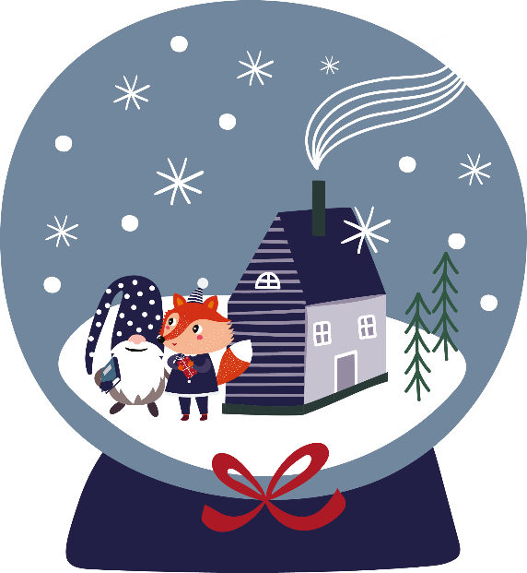
Word of the day: winter
Which adjectives might you use to describe winter?
Can you think of any similes?
Notes:
5th December
Winter is an Old English word (plural wintru), meaning ‘the fourth and coldest season of the year, winter,’ from Proto-Germanic ‘wintruz’. Did you know that the Anglo-Saxons counted years in ‘winters’?
Which adjectives might you use to describe winter? Can you think of any similes?

Slide 3

Word of the day:
COLD
How many synonyms for cold can you think of in 3 minutes?
Notes:
5th December
Winter is an Old English word (plural wintru), meaning ‘the fourth and coldest season of the year, winter,’ from Proto-Germanic ‘wintruz’. Did you know that the Anglo-Saxons counted years in ‘winters’?
Which adjectives might you use to describe winter? Can you think of any similes?

Slide 4
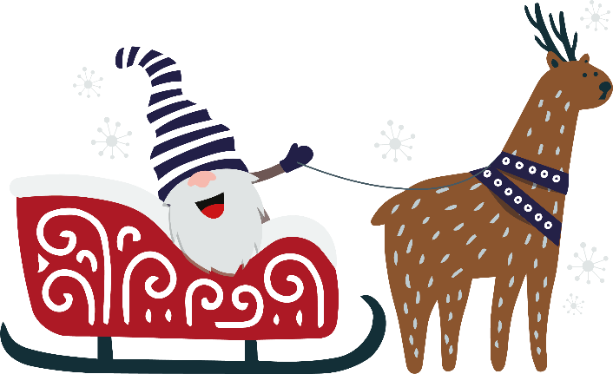
Word of the day:
Reindeer
How many other words can you list that have plurals which don’t add –s or –es?
Notes:
17th December
Day 17 #WinterWonderWords Challenge!
The #etymology: Did you know the word reindeer comes from the Old Norse words ‘hreinn’ meaning ‘reindeer’, and ‘dýr’ meaning ‘animal’?
https://hfl.mobi/Wordutopia

Slide 5
Word of the day: sleigh
Can you think of specific nouns for vehicles?
e.g. bulldozer, tank, hot air balloon
Notes:
16th December
Day 17 #WinterWonderWords Challenge!
The #etymology: A sleigh is a "vehicle mounted on runners for use on ice and snow," from a Dutch word first recorded in 1703 ‘slee’, shortened from ‘slede’.
https://hfl.mobi/Wordutopia

Slide 6

Word of the day:
Snow
How many compound words can you create using the word ‘snow’? e.g. snowball
Notes:
19th December
Day 19 #WinterWonderWords Challenge!
The #etymology: Did you know that the word ‘snow’ derives from the old English word ‘snaw’, meaning ‘snow; that which falls as snow’?
https://hfl.mobi/Wordutopia

Slide 7
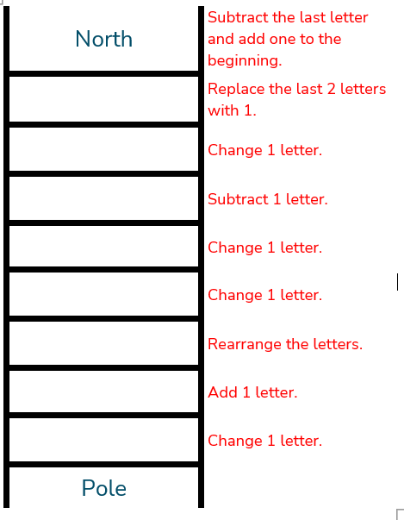

Word of the day:
North Pole
Can you follow the clues to complete the word ladder from Professor Tim Rasinski?
Notes:
^{20th} December
Day 20 #WinterWonderWords Challenge
The #etymology: North comes from the Old English ‘nord’, meaning ‘lying to the North’. Pole – referring to the ‘northern or southern end of Earth's axis’ - is directly from Latin ‘polus’ meaning ‘end of an axis’ and ‘the sky, the heavens’.
https://hfl.mobi/Wordutopia
A slide with the #WinterWonderWords challenge of the day on it.
The word of the day is: spectacular
The challenge of the day is: How many words can you find with the root word 'spect'?
Beneath, is the #WinterWonderWords.
In the corner, is a picture of a penguin wearing a long, pointy, red hat and a scarf, carrying a present.

Slide 8
HFL Education is a leading national provider of school improvement and business support services, training, and resources, which enable schools, educational settings and multi-academy trusts to deliver a great education. We support those we work with to achieve successful long-term outcomes for their children. We believe that every young person, through access to a great education, should be able to realise their potential, regardless of where they live, their background or circumstances.
Learn more about us by visiting our website
hfleducation.org

